Slide 1

CSC6052/5051/4100/DDA6307/MDS5110 Natural Language Processing Lecture 6-2: Prompt Engineering
Spring 2025
Benyou Wang
School of Data Science

Slide 2
Knowledge vs. Reasoning
Knowledge is storage. Reasoning is processing.

Slide 3
Knowledge vs. Reasoning
Knowledge
Definition: Knowledge refers to the information, facts, concepts, and skills that a person has acquired through experience, education, or observation.
Nature: It is often considered a static collection of data and truths about the world. Knowledge can be explicit (easily articulated and shared) or tacit (personal, context-specific, and harder to communicate).
Examples: Knowing that Paris is the capital of France, understanding the laws of physics, or having expertise in a particular field.
Reasoning
Definition: Reasoning is the cognitive process of drawing conclusions, making inferences, or forming judgments based on available information and knowledge.
Nature: It is dynamic and involves the application of logic and critical thinking to analyze situations, solve problems, and make decisions.
Examples: Deductive reasoning (drawing specific conclusions from general principles), inductive reasoning (generalizing from specific instances), and abductive reasoning (inferring the best explanation from incomplete information).
Fei Yu, Hongbo Zhang, Prayag Tiwari, Benyou Wang. Natural Language Reasoning, A Survey. ACM Computing Surveys. https://dl.acm.org/doi/10.1145/3664194

Slide 4
Difference and Connections
Key Differences
Function: - Knowledge provides the content or building blocks for reasoning. - Reasoning is the process that utilizes knowledge to arrive at conclusions.
Static vs. Dynamic: - Knowledge tends to be more static (what you know). - Reasoning is dynamic (how you use what you know).
Outcome: - Knowledge can exist without reasoning (e.g., memorized facts). - Reasoning often requires knowledge to be effective.
Interrelationship
Knowledge and reasoning are interdependent; effective reasoning relies on a solid foundation of knowledge, while acquiring new knowledge often requires reasoning skills to evaluate, integrate, and understand information.
https://www.quora.com/What-is-the-difference-between-knowledge-and-reasoning

Slide 5
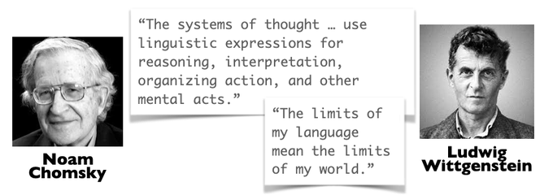
Knowledge vs. Reasoning in Humans
Knowledge is stored in languages
Human reasons via languages.
Noam Chomsky's theory of language focuses on language as a type of knowledge, rather than just a means of communication. He believes that language is a biological capacity that helps humans create social interactions.
Noam Chomsky - The Function of Language https://youtu.be/TzzuPMA8s7k?t=324
Evelina Fedorenko, Steven T. Piantadosi, Edward A. F. Gibson. Language is primarily a tool for communication rather than thought. Nature. https://www.nature.com/articles/s41586-024-07522-w

Slide 6
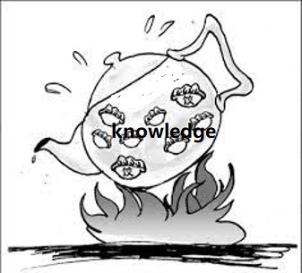
Knowledge vs. Reasoning in LLMs
How much does LLM memory a knowledge?
How does LLM think?
Inner though
reasoning
prompt
Communications
Noam Chomsky - The Function of Language https://youtu.be/TzzuPMA8s7k?t=324
Evelina Fedorenko, Steven T. Piantadosi, Edward A. F. Gibson. Language is primarily a tool for communication rather than thought. Nature. https://www.nature.com/articles/s41586-024-07522-w

Slide 7
Today’s Lecture
Knowledge in LLMs
LLMs as knowledge bases
Facts updating for LLMs
Reasoning in LLMs
Why reasoning is special in LLMs
Prompt Techniques for better reasoning

Slide 8
What is a knowledge base?

Slide 9
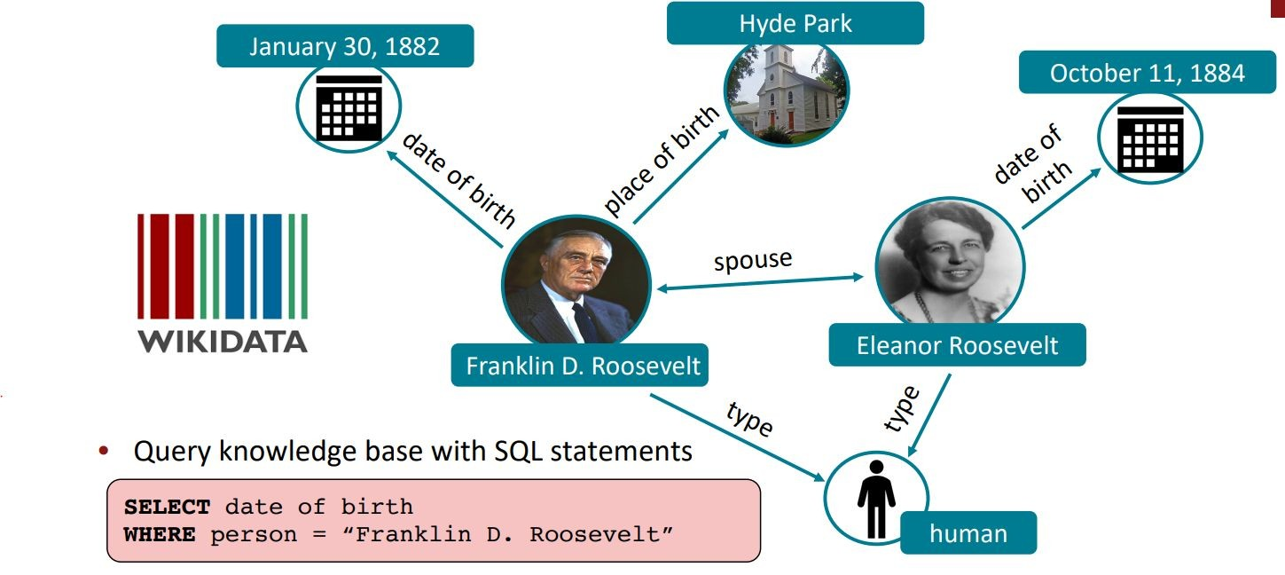

What is a knowledge base?
Graphic from Megan Leszczynski (Stanford)
knowledge base
Example
knowledge graph

Slide 10
What is a knowledge base?
Graphic from Megan Leszczynski (Stanford)
knowledge base
Example
nodes
entities or abstract classes

Slide 11
What is a knowledge base?
Graphic from Megan Leszczynski (Stanford)
knowledge base
Example
edges
relations between entities

Slide 12
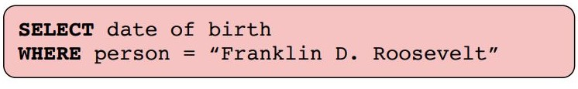
How to query?
Graphic from Megan Leszczynski (Stanford)
query

Slide 13
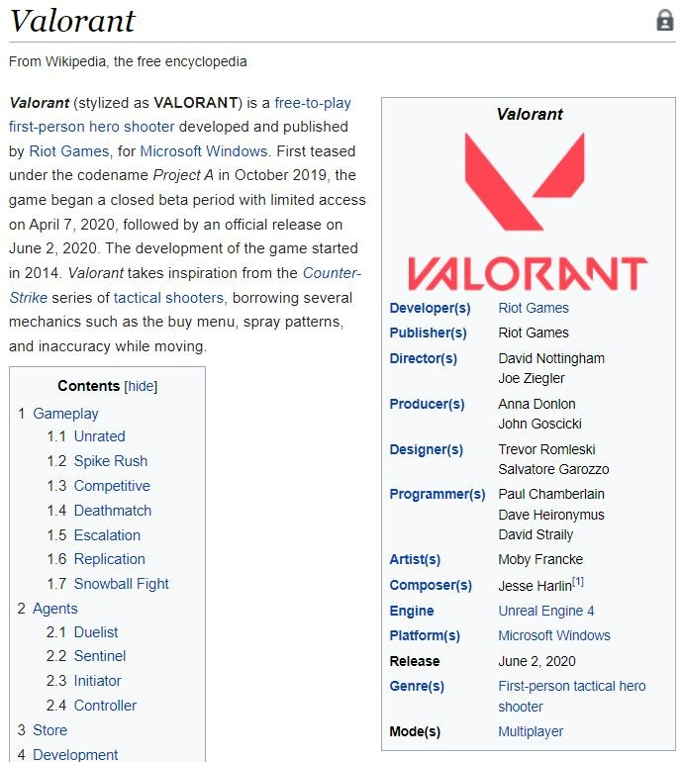
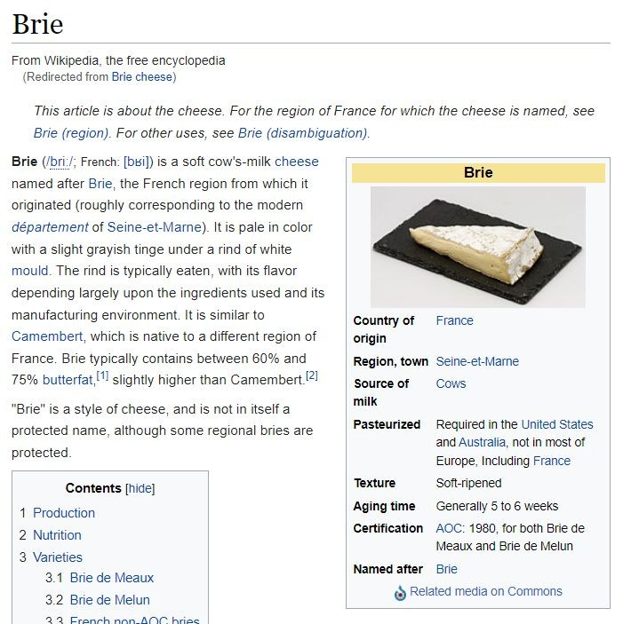
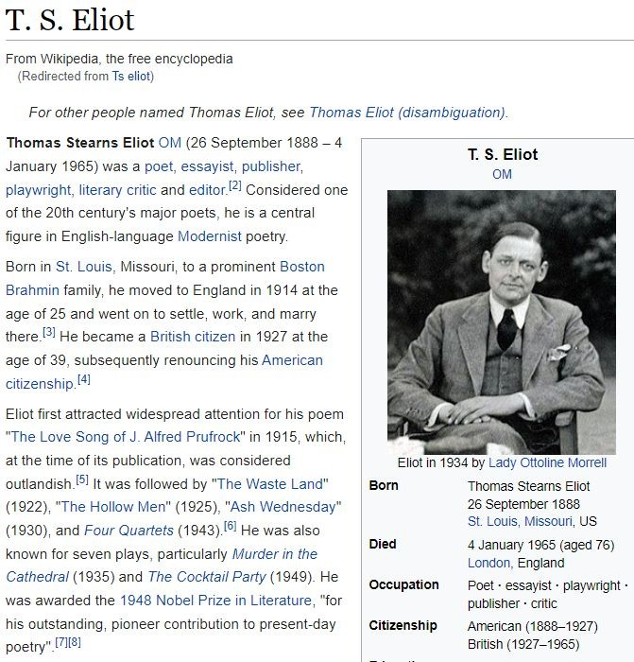
How were knowledge bases formed?
Right-most graphic from Petroni et al., 2019
unstructured text
Structured knowledge base

Slide 14
How were knowledge bases formed?
Right-most graphic from Petroni et al., 2019
Knowledge Extraction Pipeline
unstructured text
Structured knowledge base

Slide 15
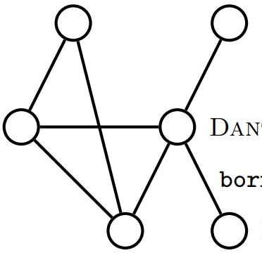
How were knowledge bases formed?
Right-most graphic from Petroni et al., 2019
Knowledge Extraction Pipeline
unstructured text
Structured knowledge base
Notes:
无结构化->结构化

Slide 16
Downsides of using knowledge bases
Right-most graphic from Petroni et al., 2019

Slide 17
Downsides of using knowledge bases
Right-most graphic from Petroni et al., 2019
Knowledge Extraction Pipeline
Data preprocessing Data merging
Entity/relation extraction Ontology extraction
. . .
Populating the knowledge base often involves complicated, multi-step NLP pipelines
27
Notes:
(1)人造+模型抽取 (2)knowledge base/graph自身缺陷：triple信息损失

Slide 18
Downsides of using knowledge bases
Right-most graphic from Petroni et al., 2019
unstructured text
“Born in St. Louis, Missouri, to a prominent Boston Brahmin family…”
Boston
BORN-IN
Knowledge Extraction Pipeline
T.S. Eliot
(T.S. Eliot, BORN-IN, Boston)
incorrect extraction
Prone to error propagation (from human annotations or knowledge extraction)

Slide 19
Downsides of using knowledge bases
Right-most graphic from Petroni et al., 2019
Q: Describe Eliot’s family’s related information.
unstructured text
“Born in St. Louis, Missouri, to a prominent Boston Brahmin family…”
Boston
BORN-IN
Knowledge Extraction Pipeline
T.S. Eliot
(T.S. Eliot, BORN-IN, Boston)
incorrect extraction
Triples lead to information loss: hard to include all possible information we may be interested in.

Slide 20
Are there better alternatives? Traditional knowledge bases are inflexible and require signiﬁcant manual eﬀort.

Slide 21
Language Models as Knowledge Bases? (Petroni et al., 2019)
Notes:
主要在做探测，论证可行性

Slide 22
Language models as knowledge bases?
Image from www.slyderstavern.com
Why language models?
Scalability: pre-trained on a huge corpus of data
Time/Labor efficiency: does not require annotations/supervision
Flexibility: more ﬂexible with natural language queries
Accessibility: can be used oﬀ-the-shelf
Notes:
不需要

Slide 23
Image from www.slyderstavern.com
Do language models really store knowledge？

Slide 24

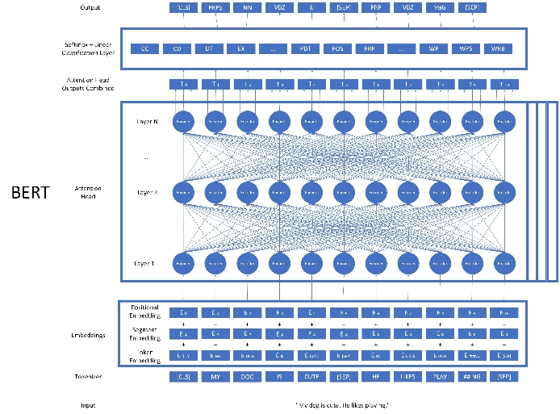
LAMA probe
probe(探针，探测)

Slide 25

LAMA Probe
Image courtesy of Patrick Lewis
Goal: evaluate factual + commonsense knowledge in language models
LAnguage Model Analysis

Slide 26
LAMA Probe
Image courtesy of Patrick Lewis
Goal: evaluate factual + commonsense knowledge in language models
Collect set of knowledge sources (i.e. set of facts) and test to see how well the modelʼs knowledge captures these facts
LAnguage Model Analysis

Slide 27
LAMA Probe
Image courtesy of Patrick Lewis
Goal: evaluate factual + commonsense knowledge in language models
Collect set of knowledge sources (i.e. set of facts) and test to see how well the modelʼs knowledge captures these facts
How do we know how “knowledgeable” a LM is about a particular fact?
LAnguage Model Analysis

Slide 28
LAMA Probe
Image courtesy of Patrick Lewis
Goal: evaluate factual + commonsense knowledge in language models
Collect set of knowledge sources (i.e. set of facts) and test to see how well the modelʼs knowledge captures these facts
How do we know how “knowledgeable” a LM is about a particular fact?
Given a cloze statement that queries the model for a missing token,
knowledgeable LMs rank ground truth tokens high and other tokens lower
LAnguage Model Analysis

Slide 29
Evaluation of LM via LAMA
Given a cloze statement that queries the model for a missing token,
knowledgeable LMs rank ground truth tokens high and other tokens lower
*according to the LM

Slide 30
Evaluation of LM via LAMA
Given a cloze statement that queries the model for a missing token,
knowledgeable LMs rank ground truth tokens high and other tokens lower
“The color of the sky is [MASK].”
Language Model
*according to the LM

Slide 31
Evaluation of LM via LAMA
Given a cloze statement that queries the model for a missing token,
knowledgeable LMs rank ground truth tokens high and other tokens lower
“The color of the sky is [MASK].”
Bob:
blue:
red: grass: grey:
.
.
.
pear:
Language Model
candidate vocab
44
*according to the LM

Slide 32
Evaluation of LM via LAMA
Given a cloze statement that queries the model for a missing token,
knowledgeable LMs rank ground truth tokens high and other tokens lower
“The color of the sky is [MASK].”
Bob: 0.003%
blue: 49%
red: 12%
grass: 0.01%
grey: 3%
. .
. .
. .
pear: 0.09%
Language Model
probability scores
*according to the LM
46

Slide 33
Evaluation of LM via LAMA
Given a cloze statement that queries the model for a missing token,
knowledgeable LMs rank ground truth tokens high and other tokens lower
“The color of the sky is [MASK].”
Bob: 0.003%
blue
most likely*
blue: 49%
red grey
.
.
.
grass pear Bob
red: 12%
grass: 0.01%
grey: 3%
. .
. .
. .
pear: 0.09%
Language Model
least likely*
probability scores
rankings
*according to the LM
46

Slide 34
Evaluation of LM via LAMA
Given a cloze statement that queries the model for a missing token,
knowledgeable LMs rank ground truth tokens high and other tokens lower
“The color of the sky is [MASK].”
P@k: precision at k
Bob: 0.003%
blue
“Does ground truth exist in the top k ranks?”
blue: 49%
red grey
.
.
.
grass pear Bob
red: 12%
grass: 0.01%
grey: 3%
. .
. .
. .
pear: 0.09%
Language Model
probability scores
rankings
47

Slide 35
Evaluation of LM via LAMA
Given a cloze statement that queries the model for a missing token,
knowledgeable LMs rank ground truth tokens high and other tokens lower
“The color of the sky is [MASK].”
Language Model #2
48

Slide 36
Evaluation of LM via LAMA
Given a cloze statement that queries the model for a missing token,
knowledgeable LMs rank ground truth tokens high and other tokens lower
“The color of the sky is [MASK].”
Bob: 0.1%
grey red
blue: 15%
red: 18%
grass: 0.04%
grey: 30%
. .
. .
. .
pear: 0.003%
blue
.
.
.
Bob grass pear
Language Model #2
probability scores
rankings
49

Slide 37
Evaluation of LM via LAMA
Given a cloze statement that queries the model for a missing token,
knowledgeable LMs rank ground truth tokens high and other tokens lower
“The color of the sky is [MASK].”
P@1: precision at rank 1
Bob: 0.1%
grey red
blue: 15%
red: 18%
grass: 0.04%
grey: 30%
. .
. .
. .
pear: 0.003%
blue
.
.
.
Bob grass pear
Language Model #2
probability scores
rankings
50

Slide 38
Evaluation of LM via LAMA
Given a cloze statement that queries the model for a missing token,
knowledgeable LMs rank ground truth tokens high and other tokens lower
“The color of the sky is [MASK].”
P@1: precision at rank 1
Bob: 0.1%
grey red
No ground truth.
P@1 = 0
blue: 15%
red: 18%
grass: 0.04%
grey: 30%
. .
. .
. .
pear: 0.003%
blue
.
.
.
Bob grass pear
Language Model #2
probability scores
rankings
51

Slide 39
Evaluation of LM via LAMA
Given a cloze statement that queries the model for a missing token,
knowledgeable LMs rank ground truth tokens high and other tokens lower
“The color of the sky is [MASK].”
P@3: precision at rank 3
Bob: 0.1%
grey red
Contains ground truth!
P@3 = 1
blue: 15%
red: 18%
grass: 0.04%
grey: 30%
. .
. .
. .
pear: 0.003%
blue
.
.
.
Bob grass pear
Language Model #2
probability scores
rankings
52
Notes:
Probability scores highlight p@1

Slide 40
Architecture of the LAMA probe

Slide 41
Architecture of the LAMA probe
Step 1: Compile knowledge sources
Fact #1
Fact #2
Fact #3
.
.
.
Fact #1
Fact #2
Fact #3
.
.
.
Knowledge Sources
54

Slide 42
Architecture of the LAMA probe
Step 2: Formulate facts into triplets or question-answer pairs
Fact #1
Fact #2
Fact #3
.
.
.
(subject, relation, object)
Fact #1
Fact #2
Fact #3
(question, answer)
.
.
.
Knowledge Sources
Facts

Slide 43
Architecture of the LAMA probe
Step 2: Formulate facts into triplets or question-answer pairs
Fact #1
Fact #2
Fact #3
.
.
.
(Mozart, BORN-IN, Austria)
Fact #1
Fact #2
Fact #3
(Who wrote Hamlet, Shakespeare)
.
.
.
Knowledge Sources
Facts

Slide 44
Architecture of the LAMA probe
Step 3: Create cloze statements, either manually or via templates
Fact #1
Fact #2
Fact #3
.
.
.
(subject, relation, object)
Cloze Statement Maker
Fact #1
Fact #2
Fact #3
.
.
.
(question, answer)
Knowledge Sources
Facts

Slide 45
Architecture of the LAMA probe
Step 3: Create cloze statements, either manually or via templates
Fact #1
Fact #2
Fact #3
.
.
.
(Mozart, BORN-IN, Austria)
Cloze Statement Maker (Template)
Fact #1
Fact #2
Fact #3
.
.
.
Knowledge Sources
Facts
Cloze Statements

Slide 46
Architecture of the LAMA probe
Step 3: Create cloze statements, either manually or via templates
Fact #1
Fact #2
Fact #3
.
.
.
(Mozart, BORN-IN, Austria)
Cloze Statement Maker (Template)
“[ SUBJECT ] was born in [MASK]”
Fact #1
manually crafted template
for “BORN-IN” relation
Fact #2
Fact #3
.
.
.
Knowledge Sources
Facts
Cloze Statements

Slide 47
Architecture of the LAMA probe
Step 3: Create cloze statements, either manually or via templates
Fact #1
Fact #2
Fact #3
.
.
.
(Mozart, BORN-IN, Austria)
Cloze Statement Maker (Template)
“[ SUBJECT ] was born in [MASK]”
Fact #1
Fact #2
Fact #3
.
.
.
manually crafted template
for “BORN-IN” relation
Knowledge Sources
Facts
Cloze Statements
60

Slide 48
Architecture of the LAMA probe
Step 3: Create cloze statements, either manually or via templates
Fact #1
Fact #2
Fact #3
.
.
.
(Mozart, BORN-IN, Austria)
Cloze Statement Maker (Template)
“ Mozart was born in [MASK]”
Fact #1
Fact #2
Fact #3
manually crafted template
for “BORN-IN” relation
.
.
.
Knowledge Sources
Facts
Cloze Statements

Slide 49
Architecture of the LAMA probe
Step 3: Create cloze statements, either manually or via templates
Fact #1
Fact #2
Fact #3
.
.
.
Cloze Statement (Manual)
Fact #1
Fact #2
Fact #3
(Who wrote Hamlet, Shakespeare)
.
.
.
Knowledge Sources
Facts
Cloze Statements

Slide 50

Architecture of the LAMA probe
Step 3: Create cloze statements, either manually or via templates
Fact #1
Fact #2
Fact #3
.
.
.
Cloze Statement (Manual)
Fact #1
Fact #2
Fact #3
.
.
.
(Who wrote Hamlet, Shakespeare)
Knowledge Sources
Facts
Cloze Statements
63

Slide 51
Architecture of the LAMA probe
Step 3: Create cloze statements, either manually or via templates
Fact #1
Fact #2
Fact #3
.
.
.
Cloze Statement (Manual)
“The writer of Hamlet is [MASK].”
Fact #1
Fact #2
Fact #3
.
.
.
human-generated statement
(Who wrote Hamlet, Shakespeare)
Knowledge Sources
Facts
Cloze Statements
64

Slide 52
More discussions on LAMA

Slide 53
Any drawbacks?
Overall pipeline of the LAMA Probe is in (Petroni et al., 2019)
Convert facts to cloze statements (either manually or using templates)
Ask LM to rank candidate vocabulary and see if ground truth is in top k rank
Can you think of any drawbacks of the probes?
Answers must be single-token
Relies on manual templates
Questions are constrained to very speciﬁc and simple types of questions

Slide 54
Data leakage: train-test overlap
[Testing] Many of the knowledge sources were extracted from Wikipedia
[Training] However, pre-training corpora for language models almost always contain data from Wikipedia…
How much of the amazing knowledge retrieval is due to train-test overlap in the knowledge probing benchmarks?

Slide 55
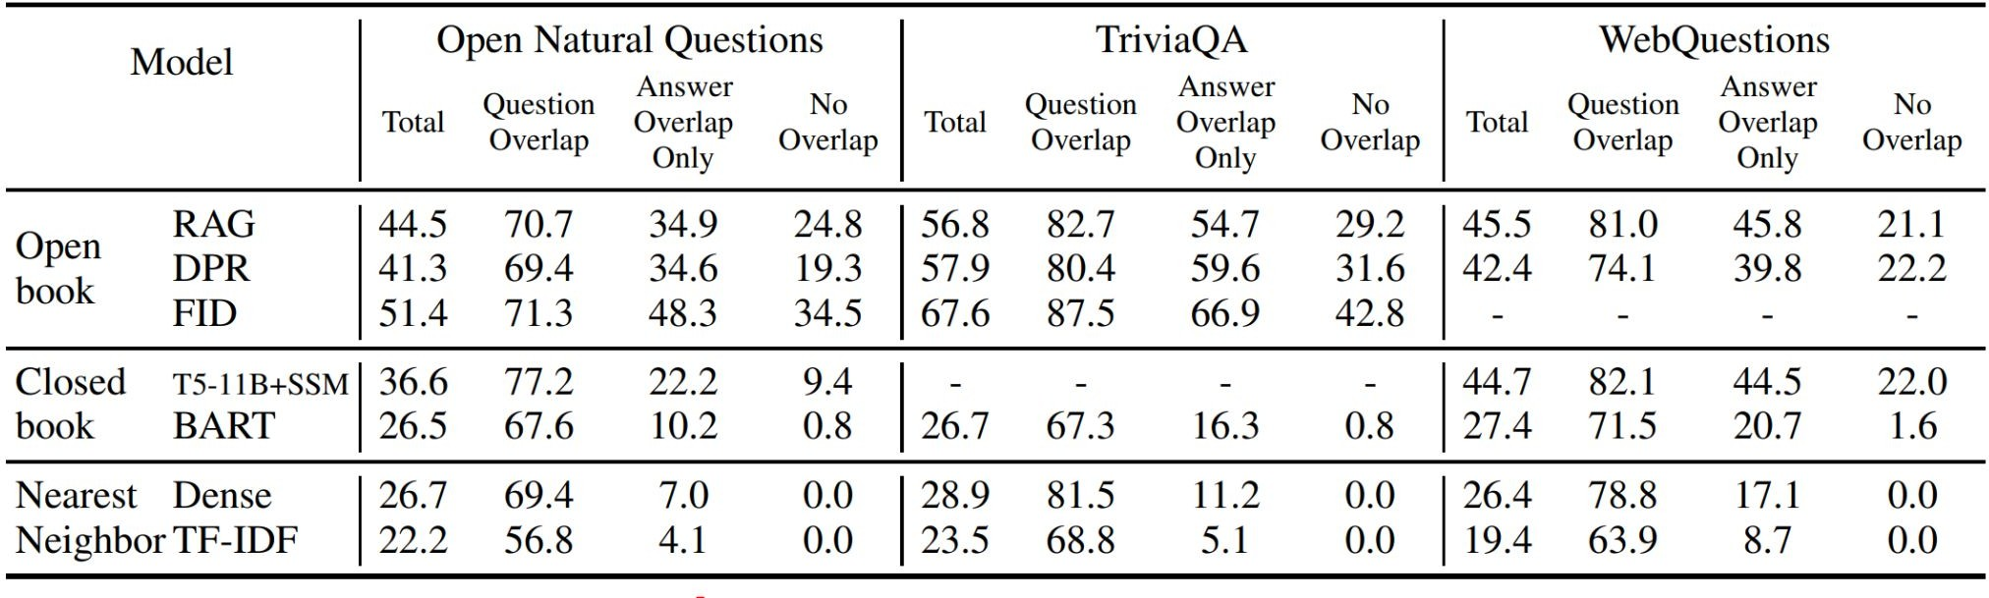
Train-test overlap is responsible for LMʼs ability to do knowledge retrieval! (Lewis et al., 2020)
Table from Lewis et al., 2020
When there is question overlap, both open and closed-book LMs perform well
Notes:
假设：见过了所以能学到知识->效果好

Slide 56
Train-test overlap is responsible for LMʼs ability to do knowledge retrieval! (Lewis et al., 2020)
Table from Lewis et al., 2020
But with no question or answer overlap, performance drops sharply!

Slide 57
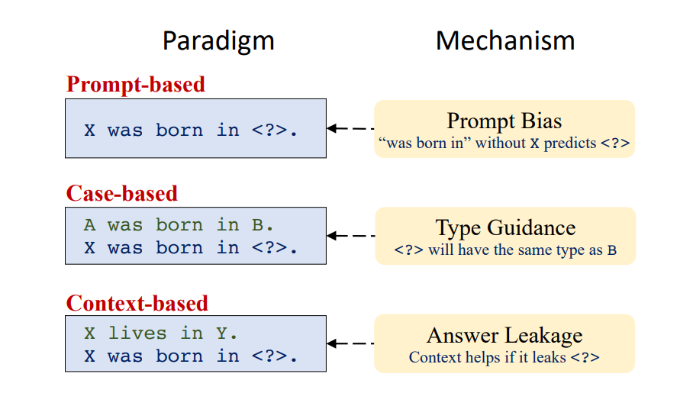
Revising LAMA – underlying mechanisms
Boxi Cao et.al. Knowledgeable or Educated Guess? Revisiting Language Models as Knowledge Bases. ACL 2021.
https://aclanthology.org/2021.acl-long.146.pdf

Slide 58
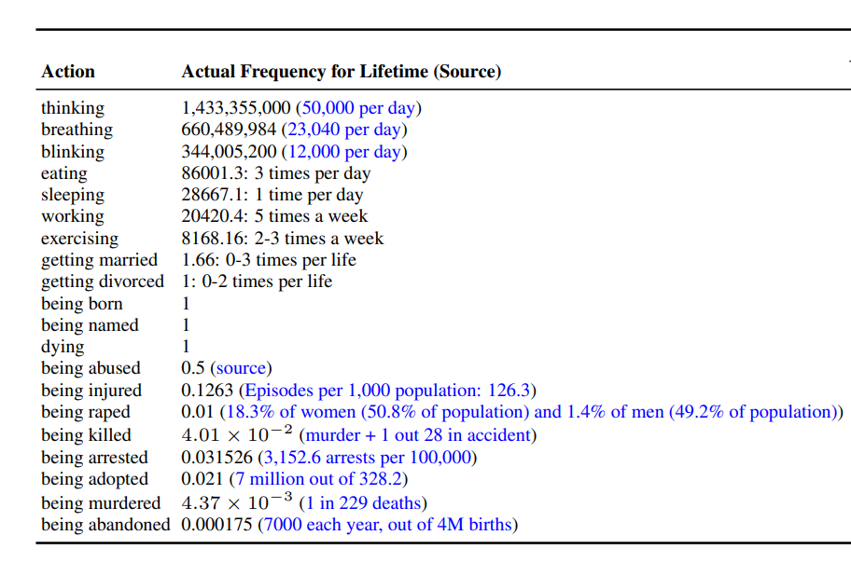
Revising LAMA – Reporting Bias
It is uninterested to say one is thinking or breathing.
But something related to murders seems interesting to share

Slide 59
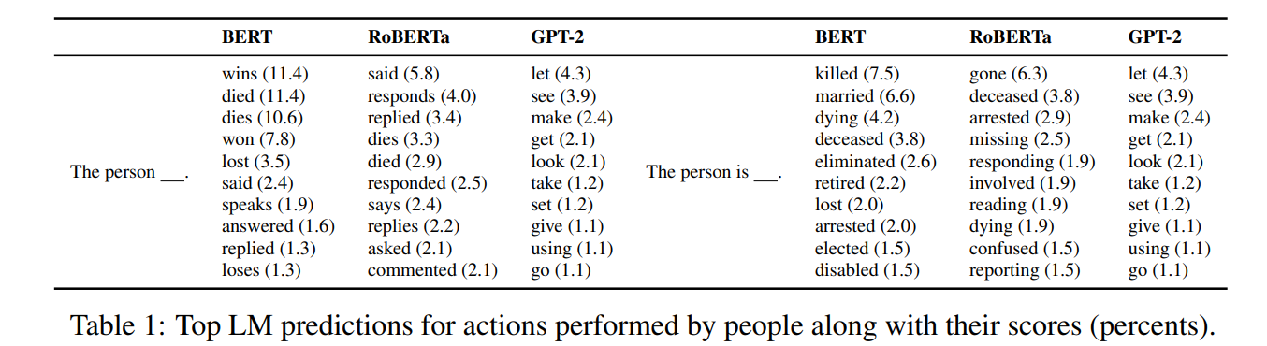
Revising LAMA – Reporting Bias
Reporting bias: due to Grice’s conversational maxim of quantity (Grice et al., 1975), people rarely state the obvious, thus many trivial facts (“people breathe”) are rarely mentioned in text, while uncommon events (“people murder”) are reported disproportionately (Gordon and Van Durme, 2013; Sorower et al., 2011).
Vered Shwartz and Yejin Choi. Do Neural Language Models Overcome Reporting Bias?. COLING 2020. https://aclanthology.org/2020.coling-main.605.pdf

Slide 60
Today’s Lecture
Knowledge in LLMs
LLMs as knowledge bases
Facts updating for LLMs
Reasoning in LLMs
Why reasoning is special in LLMs
Prompt Techniques for better reasoning

Slide 61
How to update knowledge in pre-trained models?

Slide 62
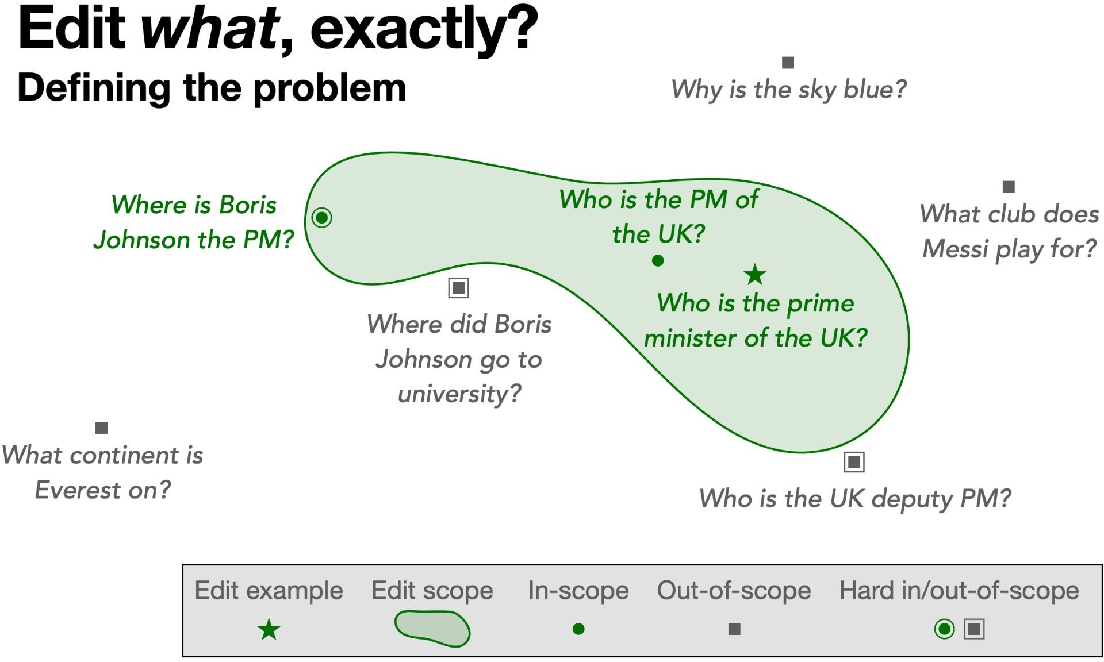
Edit What, Exactly?
Deﬁning the problem
True answer: Boris Johnson
https://web.stanford.edu/class/cs224n/slides/cs224n-2022-lecture-editing.pdf

Slide 63
Edit What, Exactly?
Deﬁning the problem
True answer: Boris Johnson
https://web.stanford.edu/class/cs224n/slides/cs224n-2022-lecture-editing.pdf

Slide 64
Edit What, Exactly?
Deﬁning the problem
True answer: Boris Johnson
https://web.stanford.edu/class/cs224n/slides/cs224n-2022-lecture-editing.pdf

Slide 65
Edit What, Exactly?
Deﬁning the problem
True answer: Boris Johnson
https://web.stanford.edu/class/cs224n/slides/cs224n-2022-lecture-editing.pdf
Notes:
Sky blue和其他out-of-scope一起出来
Hard examples标注原因
添加正确答案

Slide 66
How to edit knowledge in pre-trained models?

Slide 67
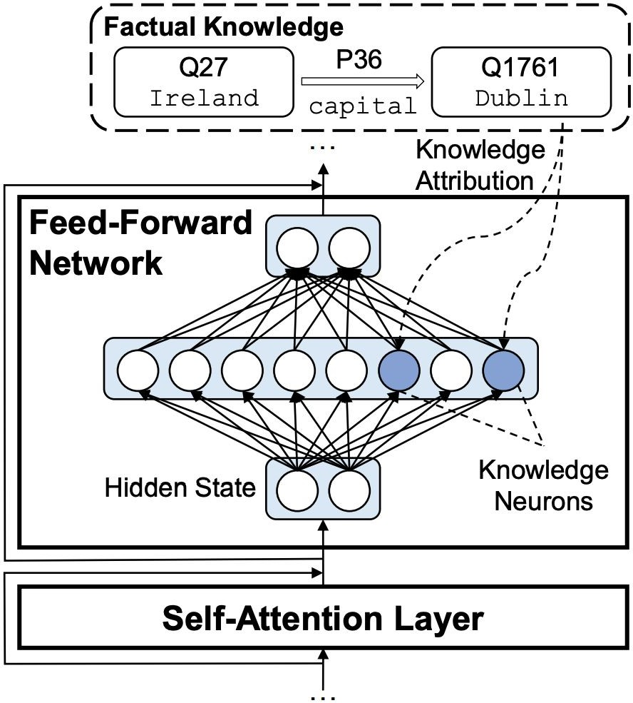
Knowledge Neurons
What is a knowledge neuron
Activations after the ﬁrst feed-forward layer
Assumption
Knowledge neuron are associated with factual knowledge
Implications
If we can identifying these neurons, we can alter them to edit (update/erase) knowledge.
No additional training is involved.
Dai, Damai, et al. "Knowledge neurons in pretrained transformers." arXiv preprint arXiv:2104.08696 (2021).
Notes:
侧重为什么做这篇工作
原文如何编辑知识，从识别到编辑之间的逻辑gap

Slide 68
Identify knowledge neurons
Given a relational fact e.g. (Mozart, BORN-IN, Austria)
produce N diverse prompts;
for each prompt, calculate the knowledge attribution scores of neurons;
for each prompt, retain the neurons with attribution scores greater than the attribution threshold T, obtaining the coarse set of knowledge neurons;
considering all the coarse sets together, retain the knowledge neurons shared by more than p% prompts.
Dai, Damai, et al. "Knowledge neurons in pretrained transformers." arXiv preprint arXiv:2104.08696 (2021).
Notes:
Hard to simplify, many concepts are not introduced

Slide 69
Knowledge neuron editing
Knowledge neuron: activations after the first feed-forward layer
Suppressing the neuron: activation = 0
Amplifying the neuron: activation = 2*activation

Slide 70
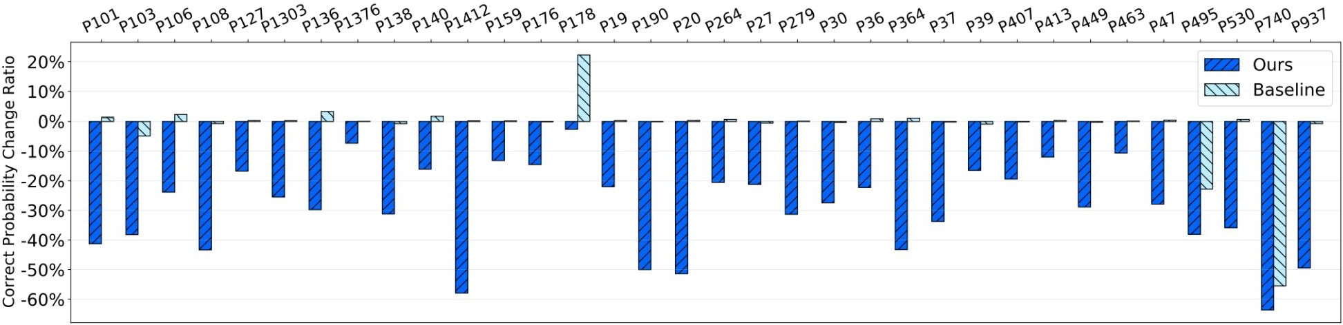
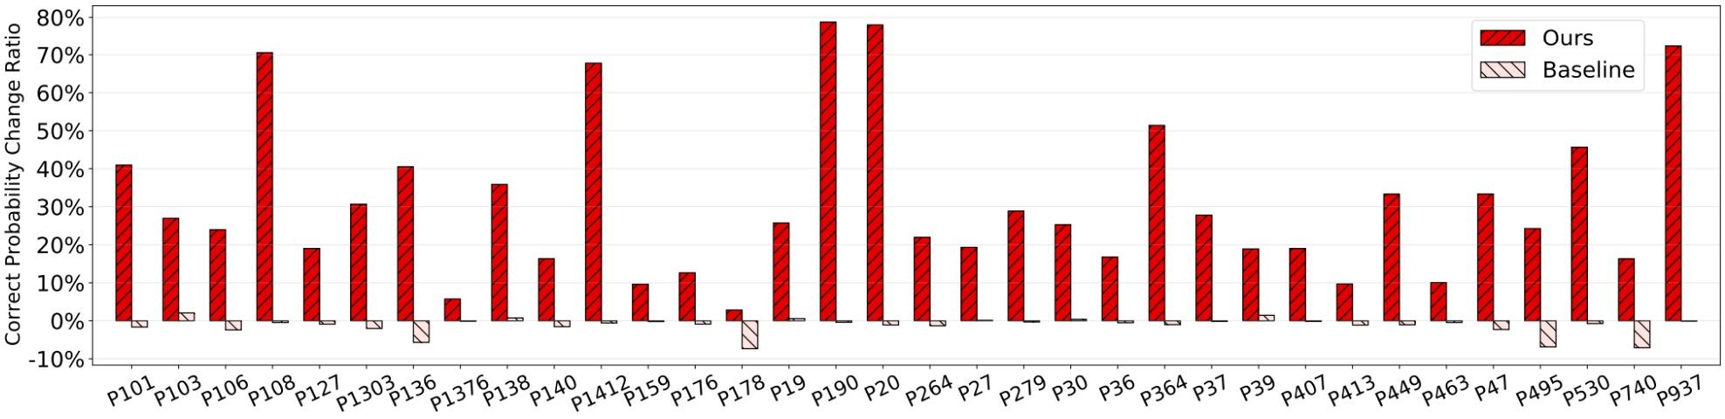
Suppressing or Amplifying Knowledge Neurons
Suppressing the neurons hurt performance and amplifying neurons increase performance by up to 30% on average.
Dai, Damai, et al. "Knowledge neurons in pretrained transformers." arXiv preprint arXiv:2104.08696 (2021).
Notes:
P101: one topic of the dataset, e.g. P176 (manufacturer)
Suppressing: activation = 0
Amplifying: activation = 2*activation
Task, performance on what types of application, more precise

Slide 71
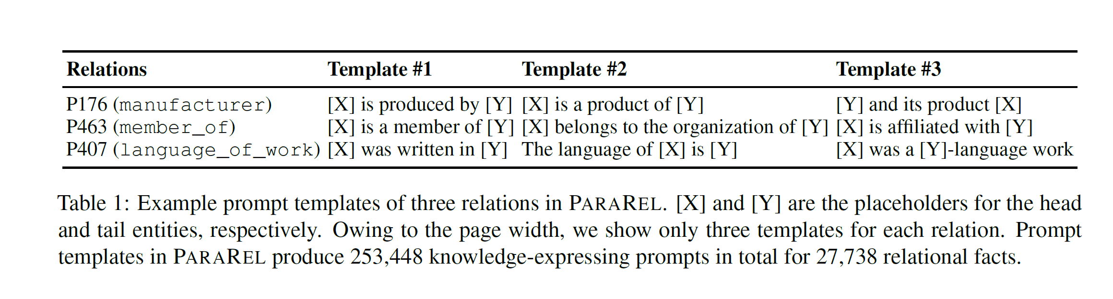
Drawback
Sensitive to the format of the prompt collected by human
Dai, Damai, et al. "Knowledge neurons in pretrained transformers." arXiv preprint arXiv:2104.08696 (2021).
Notes:
Collect corresponding prompt templates is annoying
大模型对prompt敏感，依赖于prompt形式

Slide 72
Today’s Lecture
Knowledge in LLMs
LLMs as knowledge bases
Facts updating for LLMs
Reasoning in LLMs
Why reasoning is special in LLMs
Prompt Techniques for better reasoning

Slide 73
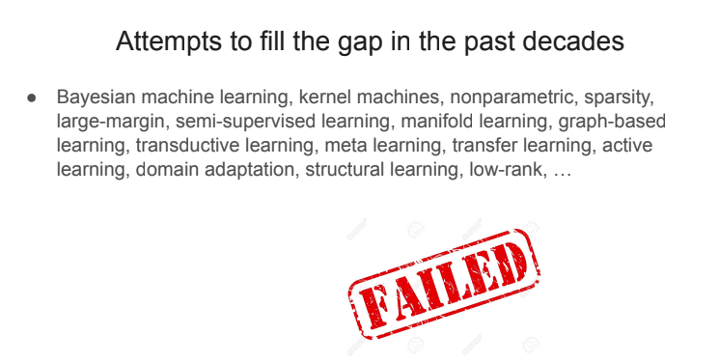
Human Intelligence vs. Traditional machine learning? (Hint: reasoning)
Humans | Traditional machine learning
Learn from only a few examples | Large amounts of labeled data
Can explain rationale for decisions | Black box
Out-of-distribution generalization | No
Teaching language models to reason (Denny Zhou), 2023.

Slide 74
Multi-step reasoning is hard for language models
Sentiment = negative
This movie sucks!
“type 1”
Novak Djokovic wins the 2021 French Open.
Topic = Tennis
Thank you!
Translation: 谢谢!
Language Model
Take the last letters of the words in "Elon Musk" and concatenate them.
“uk”
(“nk”)
“type 2”
The cafeteria had 23 apples. If they used 20 to make lunch and bought 6 more, how many apples do they have?
27
(9)

Slide 75
What do language models learn from next-word prediction?
[thousands (millions?) more]
Extreme multi-task learning!
Grammar | In my free time, I like to {run, banana}
Lexical semantics | I went to the zoo to see giraffes, lions, and {zebras, spoon}
World knowledge | The capital of Denmark is {Copenhagen, London}
Sentiment analysis | Movie review: I was engaged and on the edge of my seat the whole time. The movie was {good, bad}
Harder sentiment analysis | Movie review: Overall, the value I got from the two hours watching it was the sum total of the popcorn and the drink. The movie was {bad, good}
Translation | The word for “pretty” in Spanish is {bonita, hola}
Spatial reasoning | [...] Iroh went into the kitchen to make some tea. Standing next to Iroh, Zuko pondered his destiny. Zuko left the {kitchen, store}
Math question | First grade arithmetic exam: 3 + 8 + 4 = {15, 11}

Slide 76
What can’t language models learn from next-word prediction?
Current world knowledge | The stock price of APPL on March 1st, 2023 is {???}
Arbitrarily long arithmetic | 36382894730 + 238302849204 = {???}
Many-step reasoning | Take the nineteenth digit of Pi and multiply it by the e to the fourth power. The resulting ones-digit of the resulting number is {???}
Predict the future | The winner of the FIFA world cup in 2026 is {???}
Information not in the training data | Jason Wei’s favorite color is {???}
Extremely long inputs | [2,000 page Harry Potter fan-fiction] What happened after Harry opened the chest for the second time? {???}

Slide 77
language models can do (with decent accuracy) most text tasks that an average human can do in 1 minute.
Jason Wei’s rule of thumb (经验法则)
Notes:
rule of thumb: 经验法则

Slide 78

2018
(2023)
Future …?
…
Protein discovery
Clinical diagnosis
Play chess well
High-level planning
Abstract reasoning
Simple math
Commonsense reasoning
Know world knowledge
Translation
Sentiment analysis
Generate coherent text
Be grammatically correct
…
Protein discovery
Clinical diagnosis
Play chess well
High-level planning
Abstract reasoning
Simple math
Commonsense reasoning
Know world knowledge
Translation
Sentiment analysis
Generate coherent text
Be grammatically correct
…
(?) Protein discovery
(?) Clinical diagnosis
(?) Play chess well
(?) High-level planning
(?) Abstract reasoning
Simple math
Commonsense reasoning
Know world knowledge
Translation
Sentiment analysis
Generate coherent text
Be grammatically correct
Abstract reasoning might be done in the year of 2025!

Slide 79
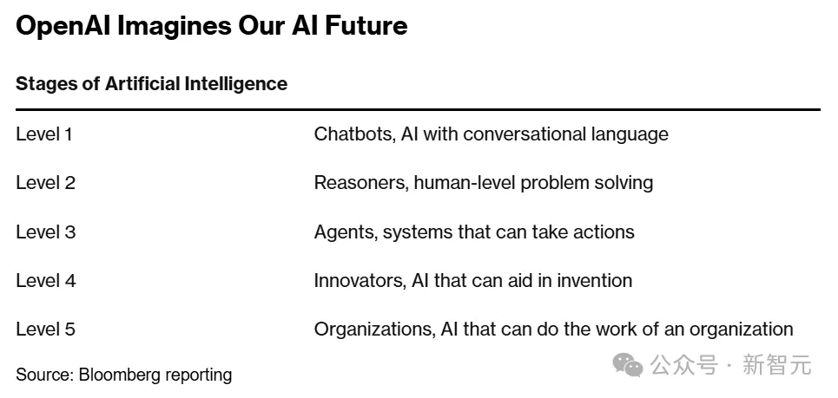

Slide 80
Reasoning Problems
Q: If there are 3 cars in the parking lot and 2 more cars arrive, how many cars are in the parking lot?
Q: Take the last letters of the words in "Elon Musk" and concatenate them
A: The answer is 5
A: The answer is nk.
Mathematical Reasoning
Symbolic Reasoning
Q: What home entertainment equipment requires cable?
Answer Choices: (a) radio shack (b) substation (c) television (d) cabinet
Q: Wolves are afraid of mice. Sheep are afraid of wolves. Emily is a wolf. What is Emily afraid of?
A: The answer is television.
A: The answer is mice.
Commonsense Reasoning
Logical Reasoning

Slide 81
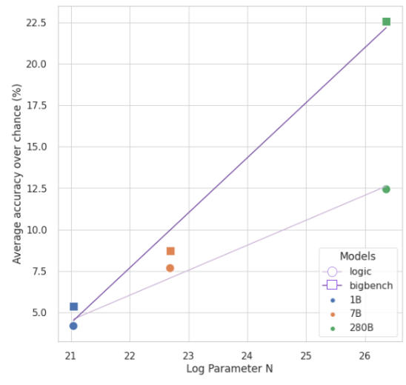
Scaling laws are worse for logical reasoning in 2022
(Creswell et al. 2022)
natural language tasks
logical reasoning tasks

Slide 82

Difficult tasks:
https://www.kaggle.com/c/ai-mathematical-olympiad-progress-prize-2

Slide 83
AIMO
What is the minimum value of $5x^2+5y^2-8xy$ when $x$ and $y$ range over all real numbers such that $|x-2y| + |y-2x| = 40$? | 800
There exists a unique increasing geometric sequence of five 2-digit positive integers. What is their sum? | 211
For how many positive integers $m$ does the equation \[\vert \vert x-1 \vert -2 \vert=\frac{m}{100}\] have $4$ distinct solutions? | 199
https://www.kaggle.com/competitions/ai-mathematical-olympiad-prize/data?select=train.csv

Slide 84
Interesting task: Mathematical modeling
#### 模型背景
物资调拨模型关注于如何高效、成本效益地将物资从供应地点分配到需求地点。在供应链管理、紧急物资分配等场景中，合理的物资调拨能够确保物资及时供应，同时降低总体成本。
#### 模型描述
假设有一组供应点集合$S$和一组需求点集合$D$。每个供应点$i \in S$具有供应能力$a_i$，每个需求点$j \in D$有需求量$b_j$。从供应点$i$到需求点$j$运输单位物资的成本为$c_{ij}$。模型的目标是确定从每个供应点到每个需求点的物资调拨量$x_{ij}$，以满足所有需求点的需求，同时最小化总运输成本。
#### 模型目标
1. **服务水平最大化**：提高物资调拨的服务水平，包括减少配送时间或提高配送的可靠性。
- 公式：$$\max S = \sum_{j \in D} \alpha_j \left(1 - \frac{\sum_{i \in S} t_{ij}x_{ij}}{T_j}\right)$$
其中，$t_{ij}$是从供应点$i$到需求点$j$的运输时间，$T_j$是需求点$j$对运输时间的最大容忍值，$\alpha_j$是与需求点$j$的服务水平重要性相关的权重。
2. **环境影响最小化**：在物资调拨过程中，尽量减少对环境的负面影响，例如减少碳排放。
- 公式：$$\min E = \sum_{i \in S}\sum_{j \in D} e_{ij}x_{ij}$$
其中，$e_{ij}$是从供应点$i$到需求点$j$运输单位物资产生的碳排放量。
3. **成本最小化**：最小化从所有供应点到所有需求点的总运输成本。
- 公式：$$\min Z = \sum_{i \in S}\sum_{j \in D} c_{ij}x_{ij}$$
4. **库存水平平衡**：优化各供应点和需求点的库存水平，以减少过剩或短缺的情况，保持库存的稳定。
- 公式：$$\min I = \sum_{i \in S} \left| x_{i} - L_i \right| + \sum_{j \in D} \left| x_{j} - L_j \right|$$
其中，$x_{i}$表示供应点$i$的实际库存水平，$x_{j}$表示需求点$j$的实际库存水平，$L_i$和$L_j$分别表示供应点$i$和需求点$j$的理想库存水平。
5. **多模式运输优化**：考虑不同运输方式（如公路、铁路、海运等）的成本和效率，优化运输模式的选择。
- 公式：$$\min M = \sum_{i \in S}\sum_{j \in D}\sum_{k \in K} c_{ijk}x_{ijk}$$
其中，$K$是运输模式的集合，$c_{ijk}$是使用运输模式$k$从供应点$i$到需求点$j$的单位运输成本，$x_{ijk}$是通过运输模式$k$从$i$到$j$的物资量。
#### 模型约束
1. **供应约束**：从每个供应点发出的物资总量不能超过该点的供应能力。
- 公式：$$\sum_{j \in D} x_{ij} \leq a_i, \quad \forall i \in S$$
2. **需求约束**：每个需求点接收的物资总量必须满足该点的需求量。
- 公式：$$\sum_{i \in S} x_{ij} = b_j, \quad \forall j \in D$$
3. **非负约束**：调拨的物资量不能为负。
- 公式：$$x_{ij} \geq 0, \quad \forall i \in S, \forall j \in D$$
4. **可选的库存水平优化约束**：对于有库存管理需求的场景，可能需要考虑库存水平的约束，确保库存水平在安全库存和最大库存水平之间。
- 示意公式：$$L_i \leq \text{库存水平}_i \leq U_i, \quad \forall i \in S$$
其中，$L_i$和$U_i$分别表示供应点$i$的安全库存水平和最大库存水平。
5. **运输模式选择约束**：确保每条运输线路只选择一种运输模式。
- 公式：$$\sum_{k \in K} x_{ijk} = x_{ij}, \quad \forall i \in S, \forall j \in D$$
这确保了从供应点$i$到需求点$j$的物资量$x_{ij}$通过某一种运输模式$k$进行调拨。
6. **时间窗约束**：满足需求点的特定配送时间窗要求。
- 公式：$$t_{ij}^{start} \leq t_{ij} \leq t_{ij}^{end}, \quad \forall i \in S, \forall j \in D$$
其中，$t_{ij}^{start}$和$t_{ij}^{end}$分别表示从供应点$i$到需求点$j$的配送允许的最早开始时间和最晚结束时间，$t_{ij}$是实际配送时间。
Xuhan Huang, Qingning Shen, Yan Hu, Anningzhe Gao, Benyou Wang. Mamo: a Mathematical Modeling Benchmark with Solvers. https://arxiv.org/abs/2405.13144v1 Findings of ACL 2024
Zhengyang Tang, Chenyu Huang, Xin Zheng, Shixi Hu, Zizhuo Wang, Dongdong Ge, Benyou Wang. ORLM: Training Large Language Models for Optimization Modeling. https://arxiv.org/abs/2405.17743 Operations Research

Slide 85
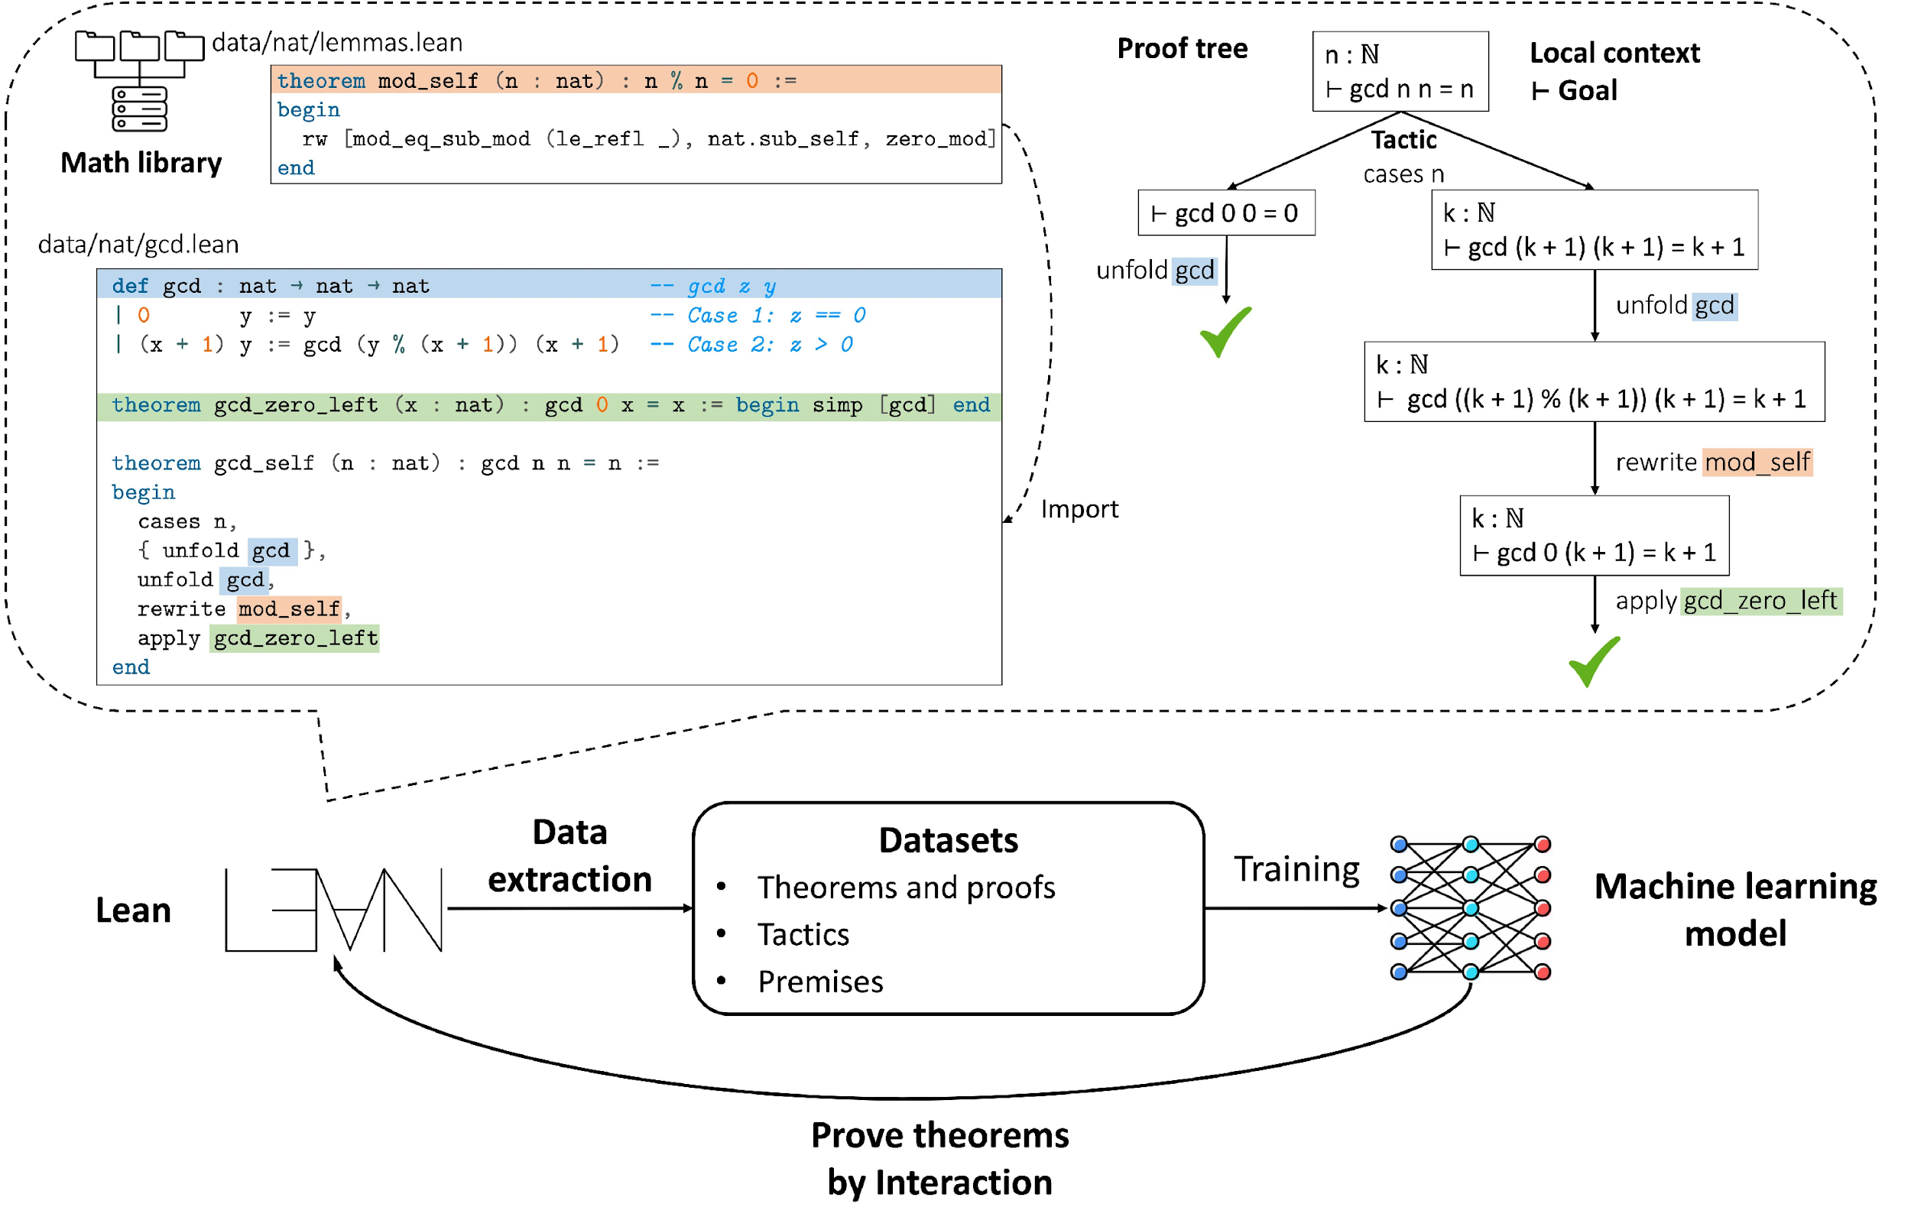
Interesting task: Automatic theorem proving

Slide 86
Today’s Lecture
Knowledge in LLMs
LLMs as knowledge bases
Facts updating for LLMs
Reasoning in LLMs
Why reasoning is special in LLMs
Prompt Techniques for better reasoning

Slide 87
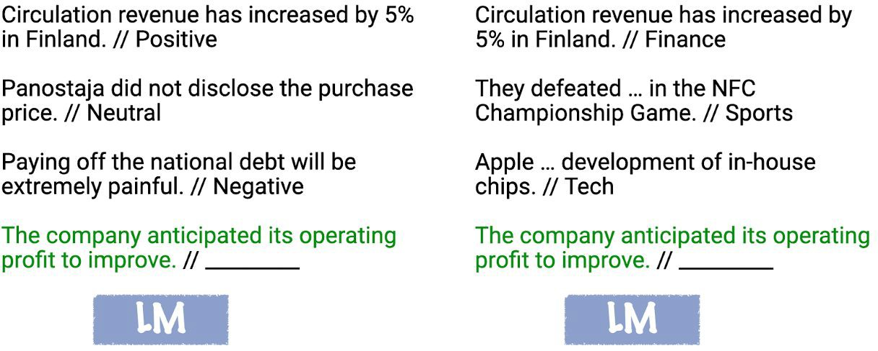
What is In-Context Learning?
https://ai.stanford.edu/blog/understanding-incontext/
2

Slide 88
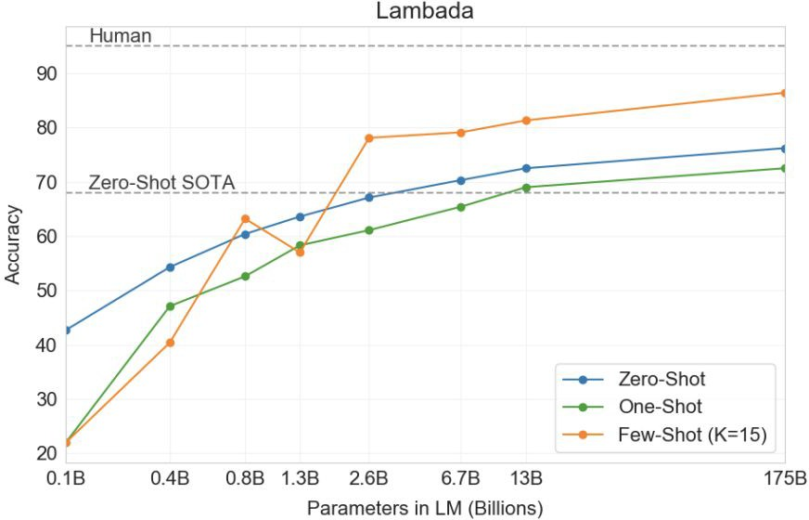
What Can In-Context Learning Do?
No parameter tuning need
Only need few examples for downstream tasks
GPT-3 improved SOTA on LAMBADA(last word prediction task) by 18%!
Works like magic!
Notes:
ICL有效性作为reference，只需展示结论

Slide 89
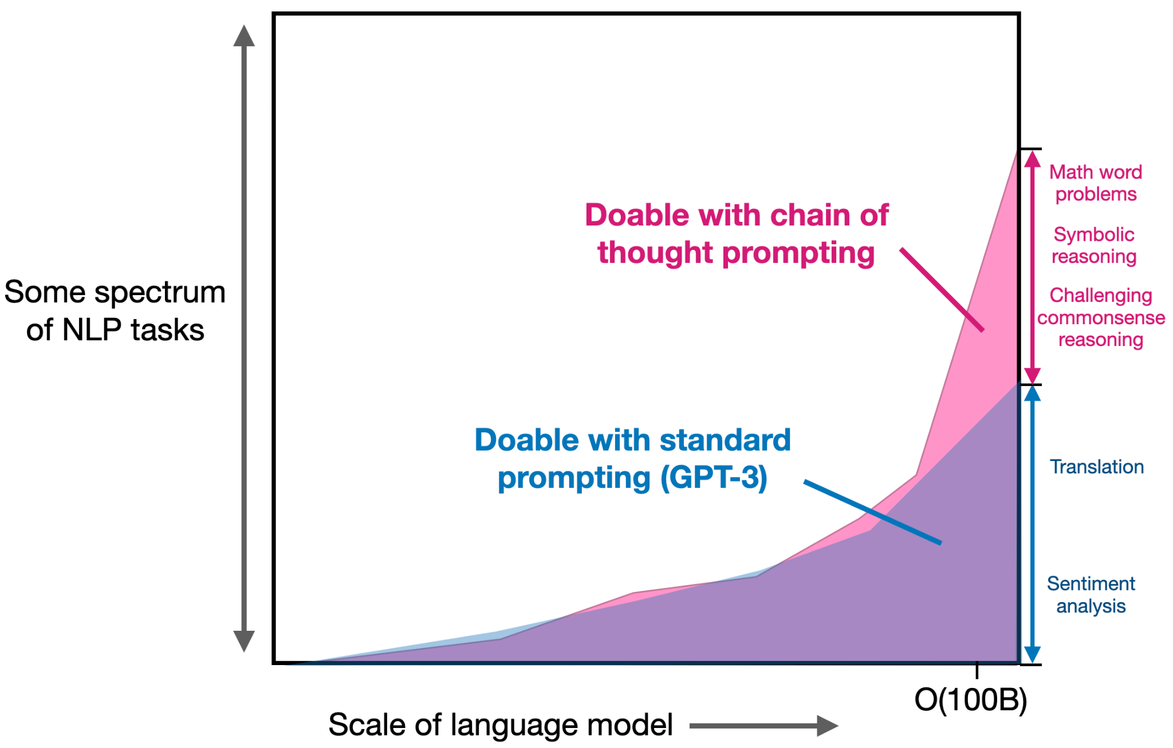
LLMs with CoT could do reason !

Slide 90
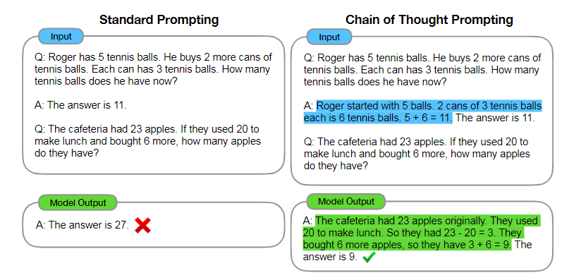
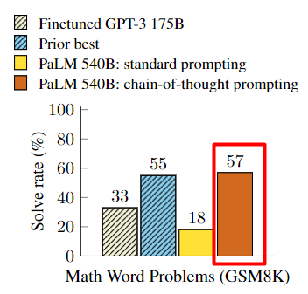
What is Chain of Thought prompting (CoT)?
<input, intermediate results, output>
decompose into easier intermediate steps
interpretable

Slide 91
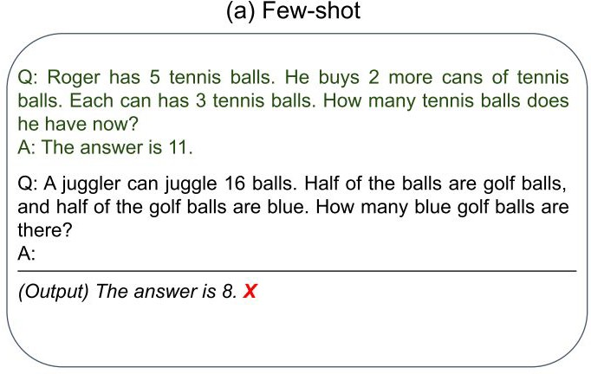
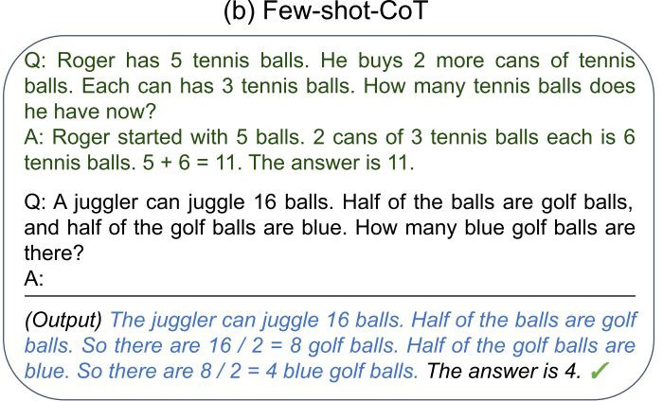
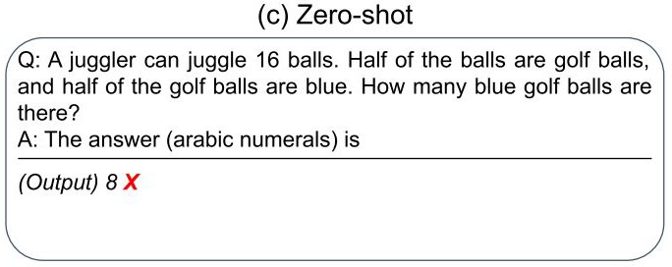
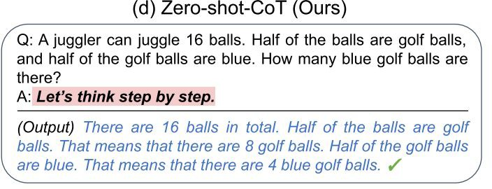
Zero-Shot CoT – Let’s think step by step
（Wei et al., 2022）
CoT Examples
Examples
Step-by-step Answer
（KoJima et al., 2022）
Step-by-step Answer
Notes:
Zero-shot: intrinsic capability
Method of zero-shot CoT is not important

Slide 92
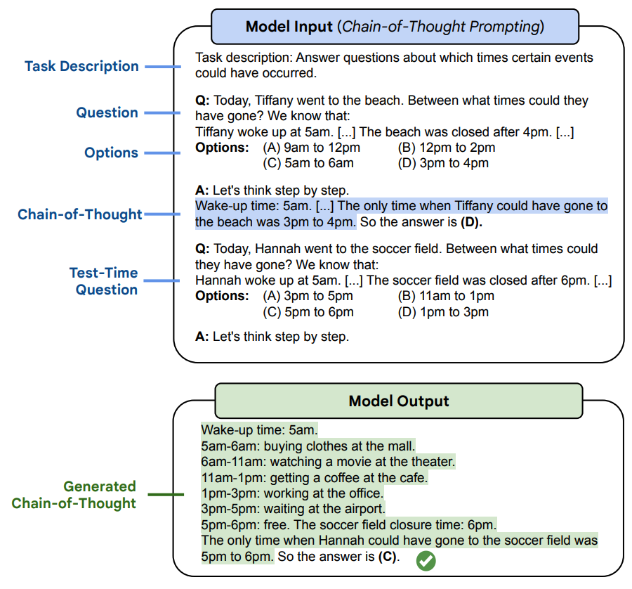
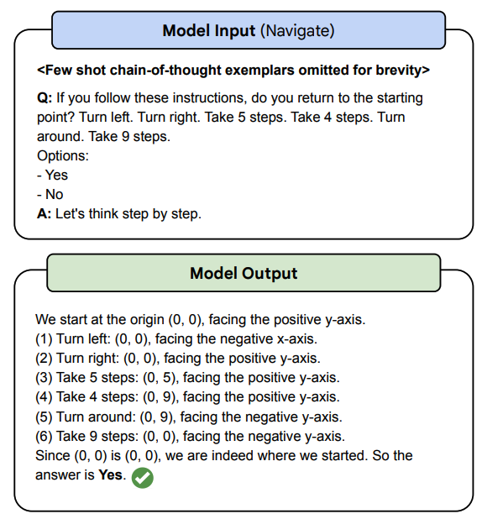
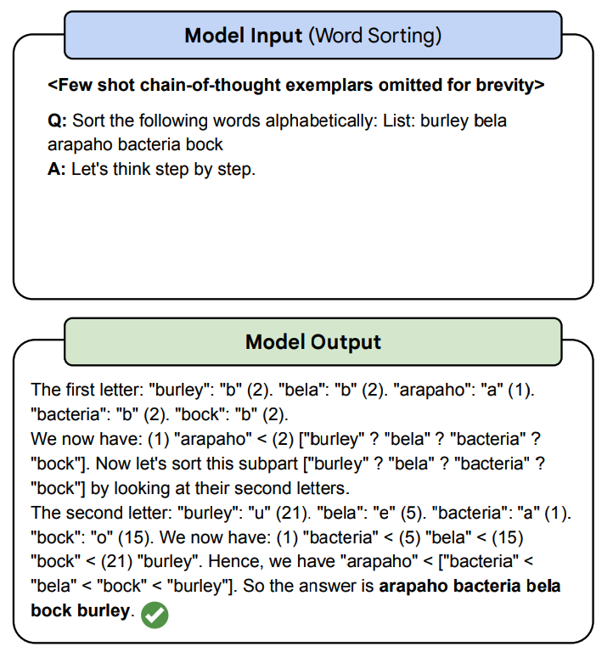
CoT on BIG-Bench: Benchmark
BIG-Bench Hard (BBH):
23 challenging tasks from BIG-Bench benchmark where no model beats avg. human rater
Challenging BIG-Bench tasks and whether chain-of-thought can solve them (2022).

Slide 93
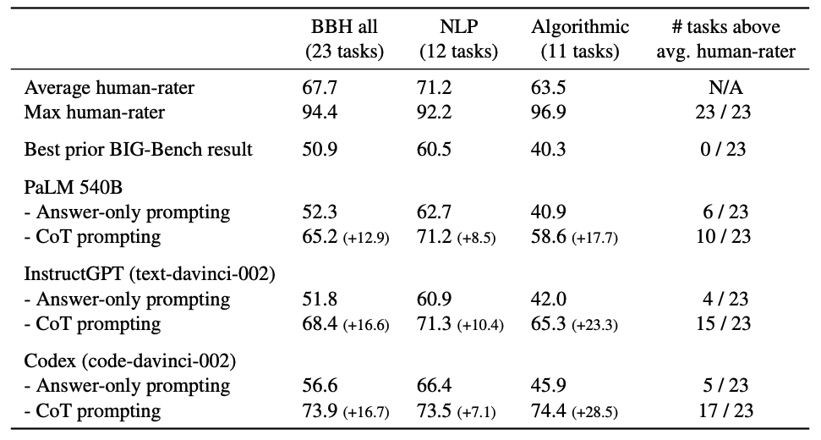
CoT on BIG-Bench: Result summary
Model much lower than average human rater
Detail: better formatting (options, task description) already beats prior best
Challenging BIG-Bench tasks and whether chain-of-thought can solve them (2023).
CoT prompting improves by performance by +16.7%, passes avg. human on majority of tasks

Slide 94
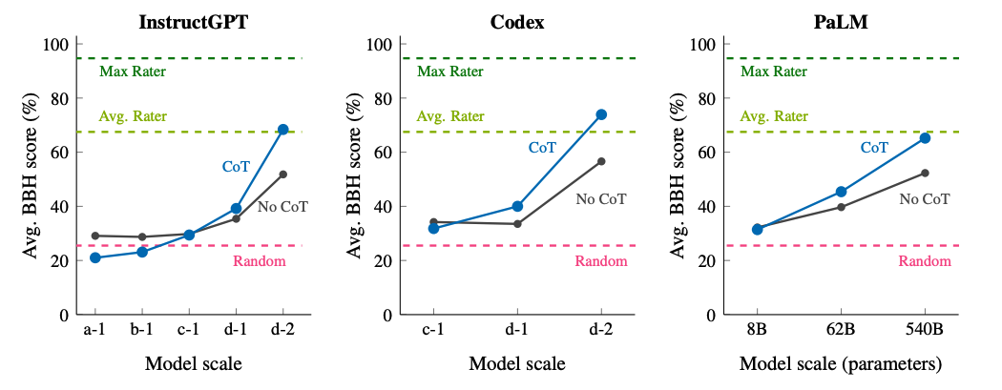
CoT on BIG-Bench: Scaling
CoT hurts performance
CoT helps performance
CoT requires sufficient model scale for positive delta
Challenging BIG-Bench tasks and whether chain-of-thought can solve them (2023).

Slide 95
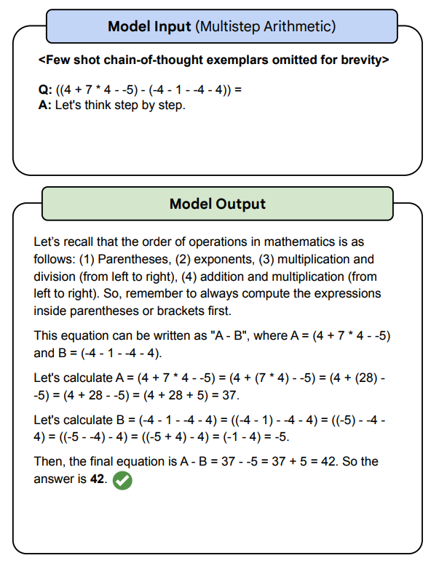
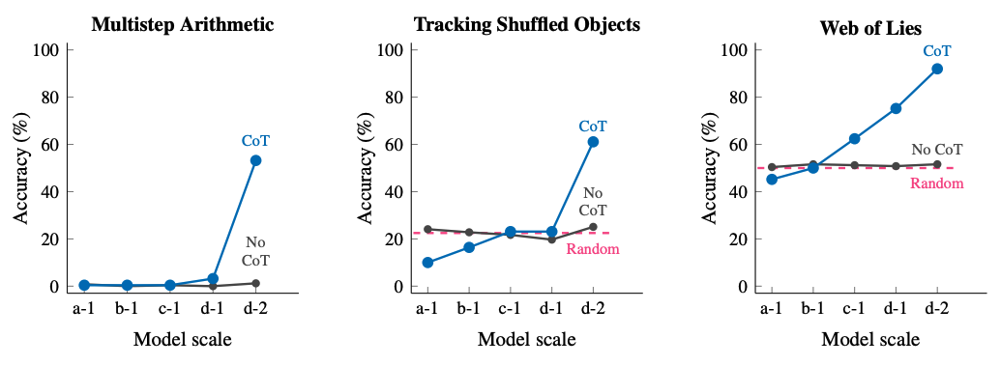
CoT on BIG-Bench: Emergence
No-CoT performance is flat, i.e., hasn’t unlocked emergence (yet :))
CoT unlocks emergent performance
Challenging BIG-Bench tasks and whether chain-of-thought can solve them (2023).

Slide 96
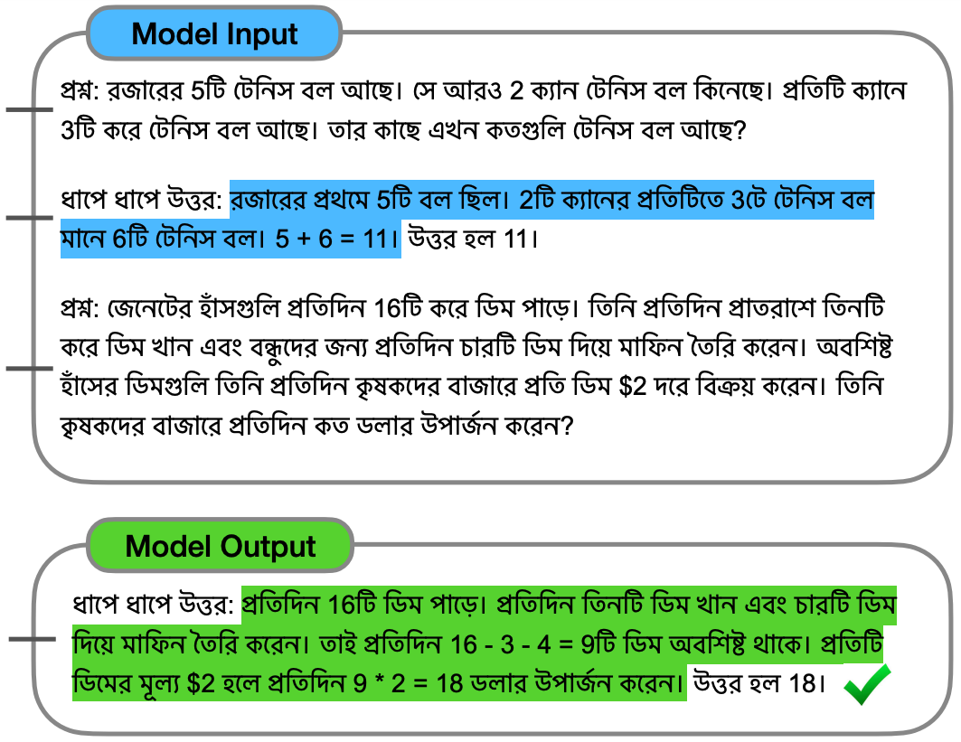
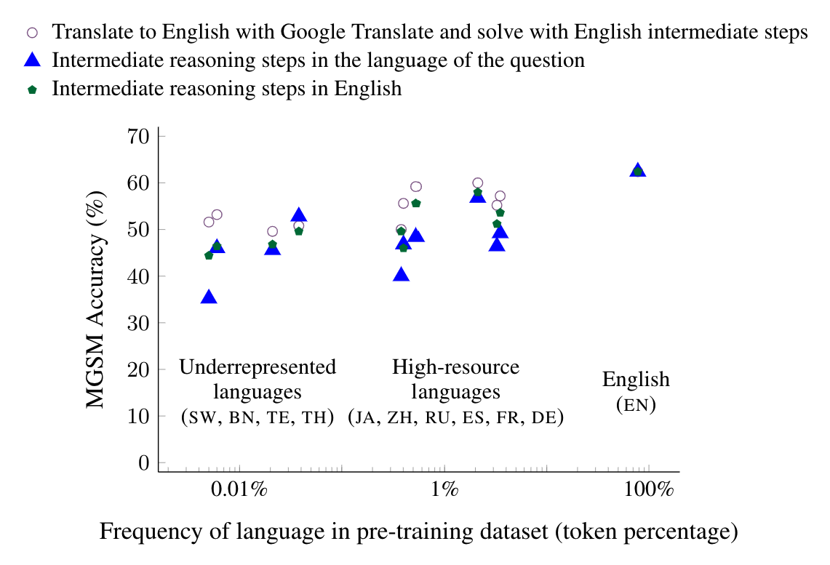
Multilingual chain-of-thought prompting
Language models are multilingual chain-of-thought reasoners (2022).
Prompt the model with Bengali math problems and Bengali reasoning
Input is highly improbable (Bengali is 0.01% of pre-training data)
Underrepresented languages did surprisingly well, demonstrating the compositionality of the model
(model is neither multilingual nor trained to do reasoning)

Slide 97
Chain-of-thought analysis
Benefits
Drawbacks
Expands the range of abilities for language models
Multi-step reasoning can now be solved!
Requires a large language model
Emergent ability
Works for any text (and image?) task
Every task has a chain-of-thought.
Higher inference cost than directly answering
CoT can be hundreds of tokens
No fine-tuning needed.
Single model, many tasks
Requires manually writing chains-of-thought in the prompts via exemplars
(Some zero-shot that works for common multi-step reasoning problems)
Some interpretability (can read chain-of-thought)
Though it’s not necessarily how the model reasons
Suggested further reading:
Large language models are zero-shot reasoners.

Slide 98
More on CoT

Slide 99
CoT is not enough
Error propagation: one incorrect step leads to cumulative errors
Chain structure limitation: the scope of exploration is limited
Uncertainty: greedy decoding may not lead to a great reasoning path
Q: Calculate (2+3)*5
A:
Calculate 2+3, we get 6
6*5 = 30
The final answer is 30
Q: Can 1, 2, 3, 4 get 24 in game 24?
A:
1+2 = 3
3*3 = 9
9+4 = 13
13 != 24
So 1,2,3,4 cannot get 24 in game 24.
Q: What is 1+2+3+…+6?
A:
1+2 = 3
3+3 = 6
6+4 = 10
10+5 = 15
15+6 = 21
So 1+2+3+4+5+6=21.
Cumulative error
Limited exploration
Correct yet not good
Notes:
逻辑关系整理
Q: Tom likes tomatoes, potatoes and cabbage. Tony likes potatoes, carrots and fish. Which dish do they both like?
**Correct Reasoning Path**:
1. List out the foods Tom likes: tomatoes, potatoes, cabbage.
2. List out the foods Tony likes: potatoes, carrots, fish.
3. Identify the common item in both lists: potatoes.
*Conclusion*: They both like potatoes.
**Incorrect Reasoning Path**:
1. Begin by examining the first item Tom likes: tomatoes.
2. Immediately conclude that since it's the first item Tom likes, it must be the dish they both like.
*Conclusion*: They both like tomatoes.
Using the correct reasoning, we can deduce that they both like potatoes. The incorrect reasoning, however, leads to the false conclusion that they both like tomatoes.

Slide 100
Improve CoT in different phases of reasoning
Pre-process of the reasoning task:
Decomposition: e.g. Least-to-most prompting
Improvement in the reasoning phase:
Tool using: e.g. PoT
Planning: e.g. ToT
Utilization of the reasoning result:
Major voting: e.g. Self-consistency
Verify: e.g. Verifier
Refine: e.g. Self-refine
Notes:
更换标题，方法改进而不是解释

Slide 101
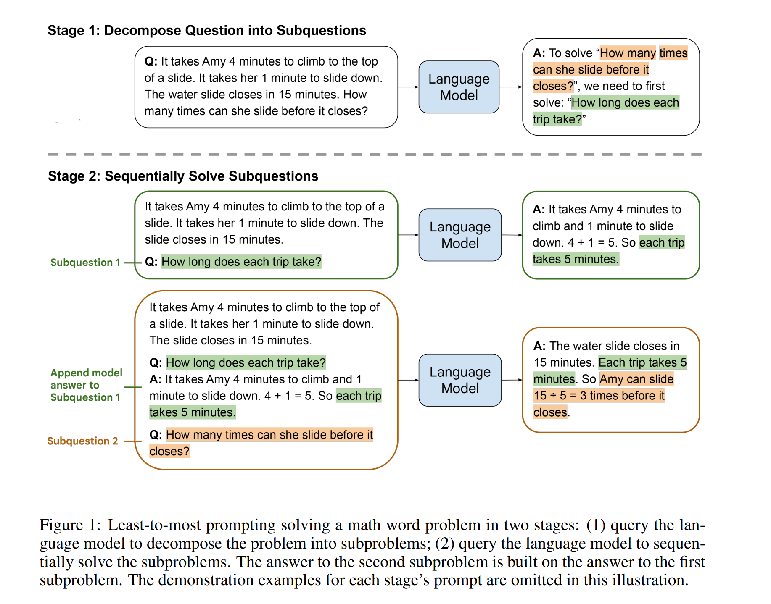
Least-to-most prompting
Explicitly decompose into subquestions
Wei, Jason, et al. "Chain-of-thought prompting elicits reasoning in large language models." Advances in Neural Information Processing Systems 35 (2022): 24824-24837.

Slide 102
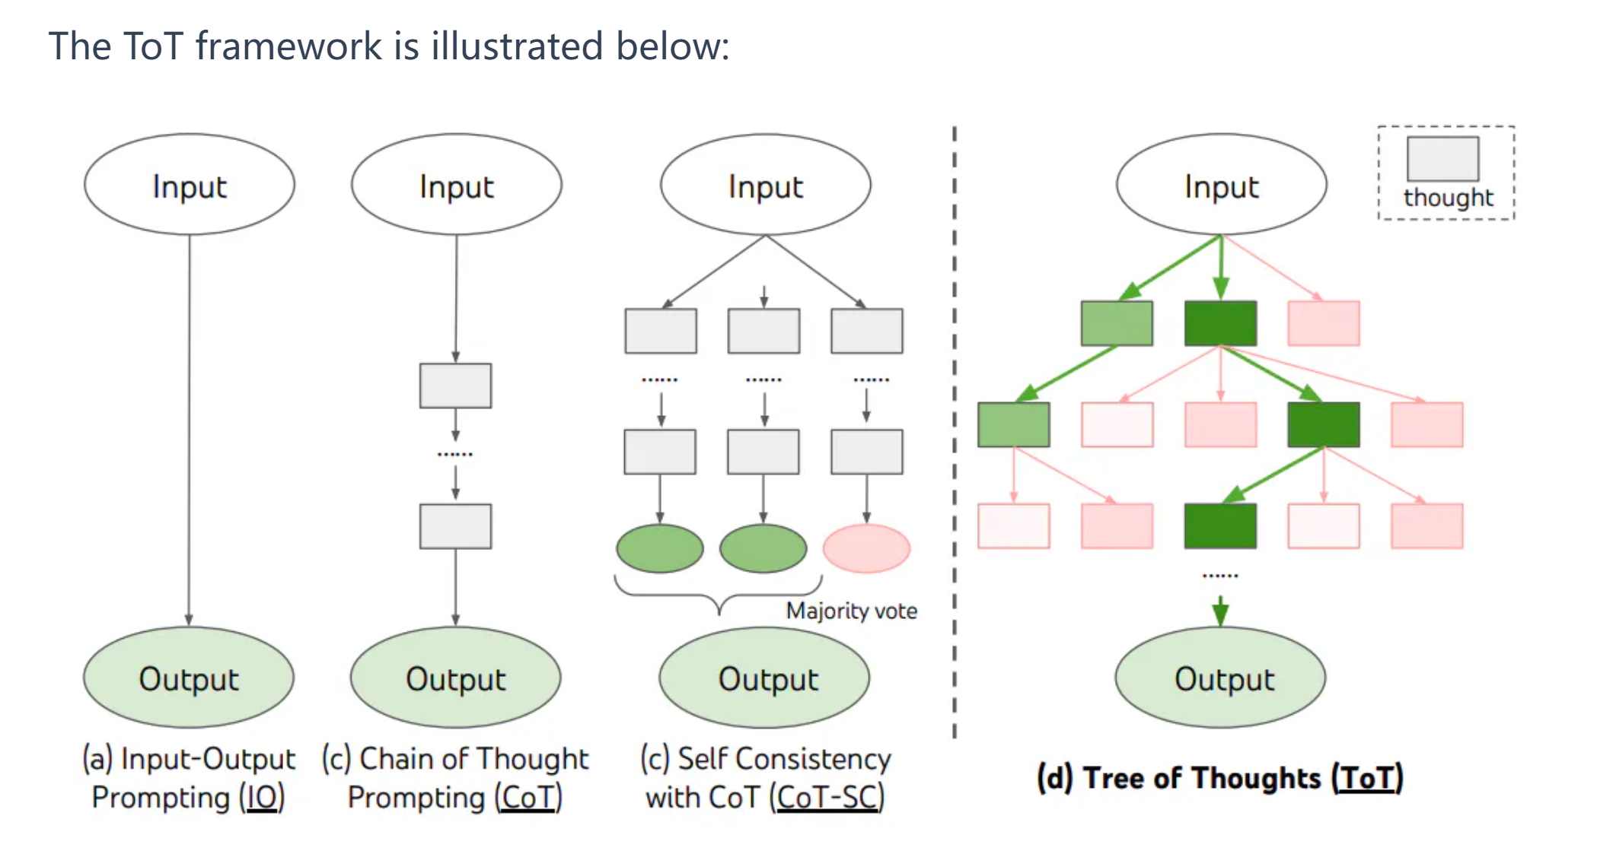
Tree of Thoughts (ToT)
Explore over units of text that serve as intermediate steps
evaluate and select
Yao, Shunyu, et al. "Tree of thoughts: Deliberate problem solving with large language models." arXiv preprint arXiv:2305.10601 (2023).

Slide 103
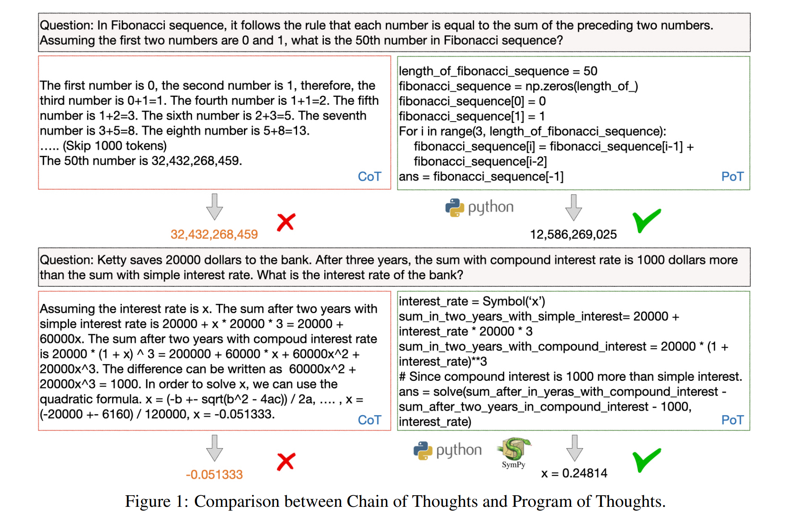
Program of Thoughts (PoT)
Output Python programs and call Python interpreter to calculate the answers
Chen, Wenhu, et al. "Program of thoughts prompting: Disentangling computation from reasoning for numerical reasoning tasks." arXiv preprint arXiv:2211.12588 (2022).

Slide 104
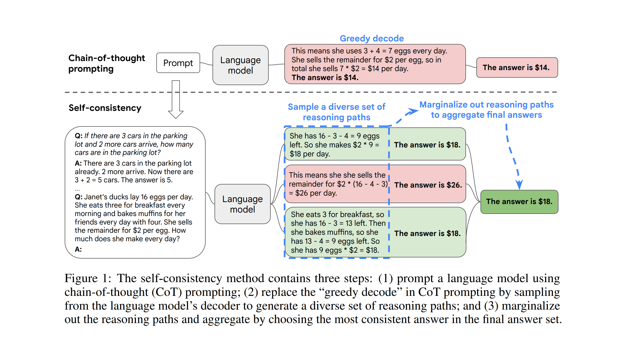
A trick for COT: Self-consistency
Wang, Xuezhi, et al. "Self-consistency improves chain of thought reasoning in language models." arXiv preprint arXiv:2203.11171 (2022).
Notes:
Cot -> error propagation? [(1) (post-selection) ensemble: self-consistency (2) TOT (in-process selection/planning)] (3) reduce error: pot (math) refine: check and correct (by model)

Slide 105
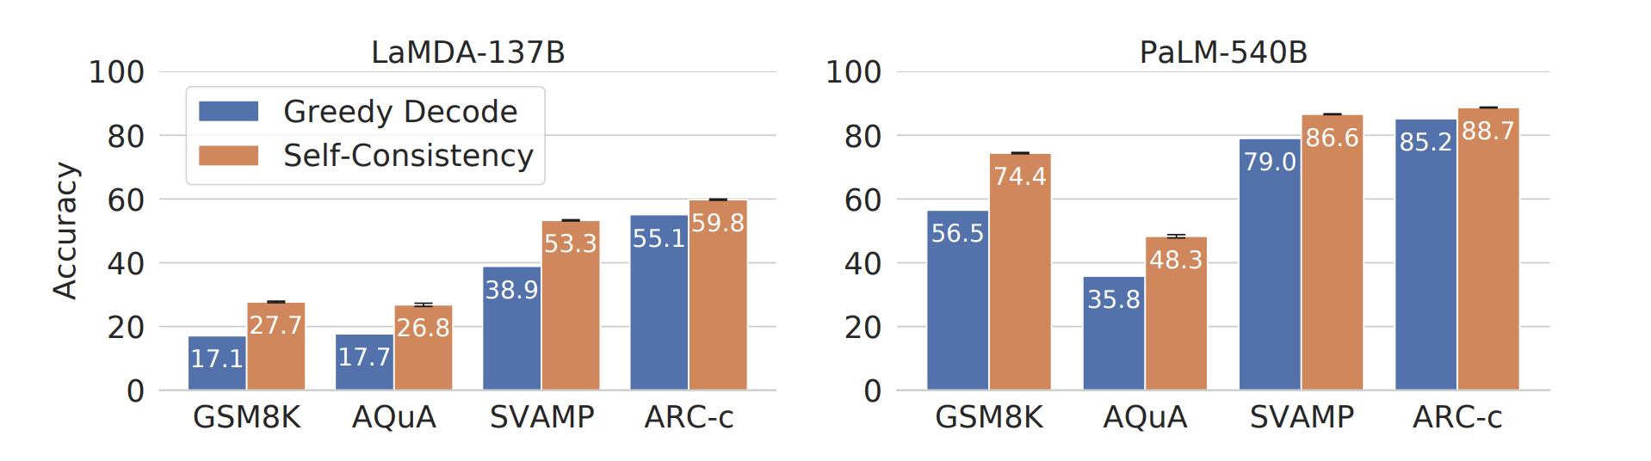
Self-consistency works really well
Big delta!

Slide 106







Verifier in COT
Verifier
Generator
(e.g. GPT)
……
……
Fei Yu, Anningzhe Gao, Benyou Wang. Outcome-Supervised Verifier for reasoning. Submitted to NAACL 2023

Slide 107
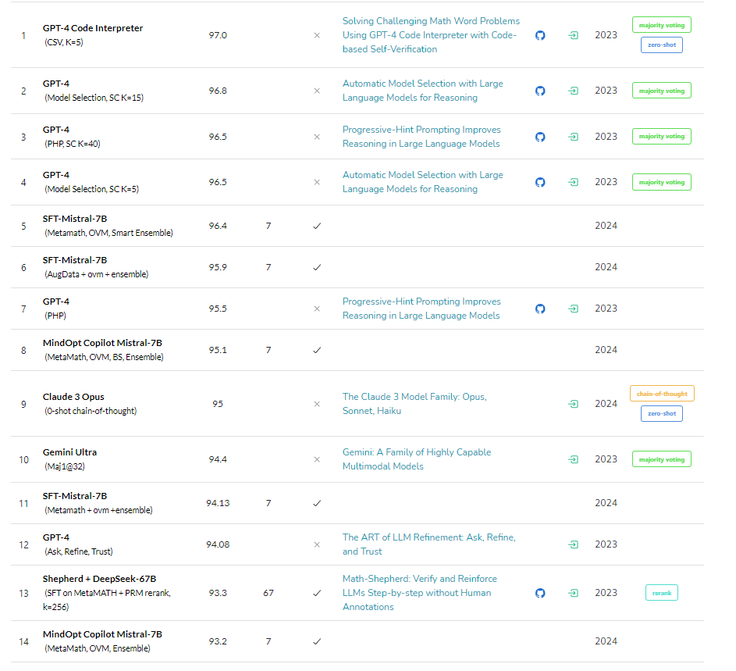
Exceed GPT 4 using our OVM in GSM-8K
https://paperswithcode.com/sota/arithmetic-reasoning-on-gsm8k

Slide 108
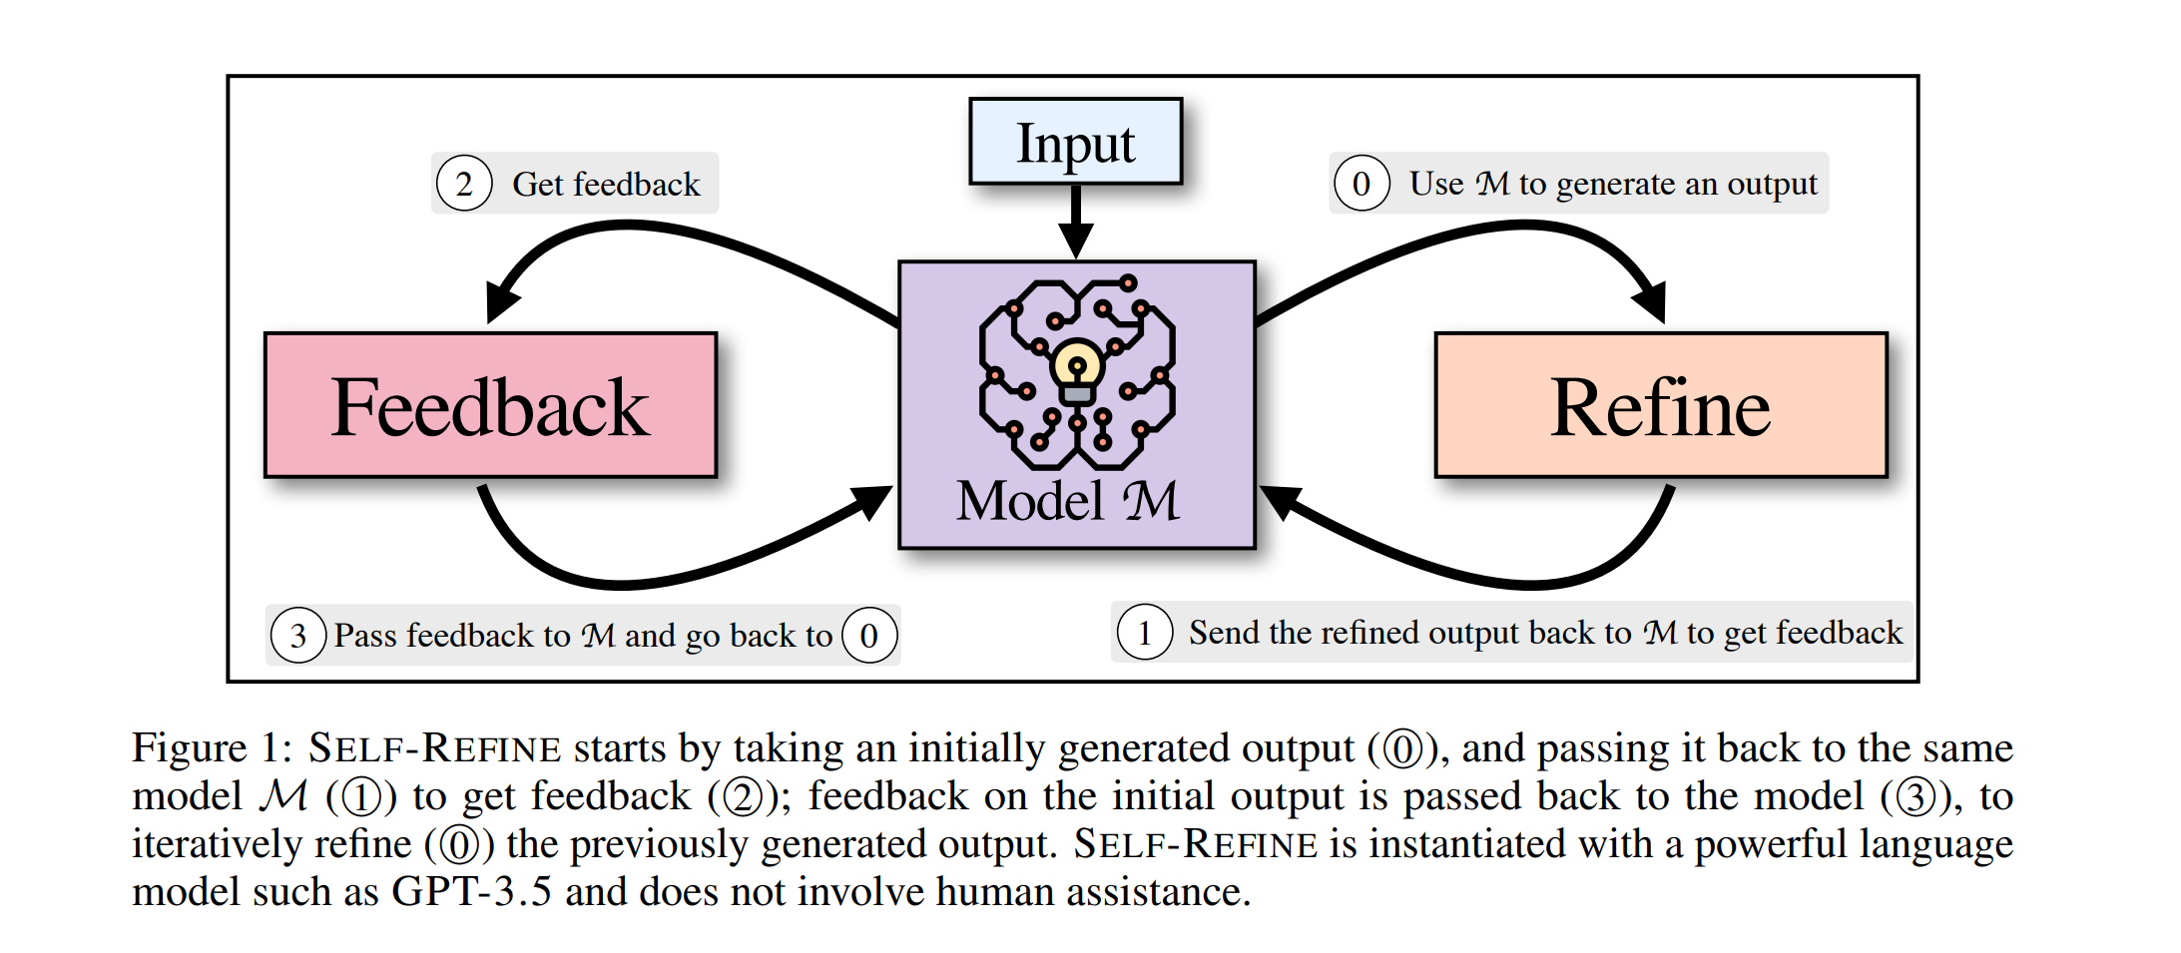
Self-refine
Madaan, Aman, et al. "Self-refine: Iterative refinement with self-feedback." arXiv preprint arXiv:2303.17651 (2023).

Slide 109
Should we employ all the techniques above?
Usually CoT can perform well under many situations
Accuracy vs Cost:
Additional techniques need more computational sources (self-consistency) or additional data processing(PoT) although these techniques can usually improve the performance.
the trade off depends on the real application.

Slide 110
Acknowledgement
Princeton COS 597G: https://www.cs.princeton.edu/courses/archive/fall22/cos597G/
Scaling, emergence, and reasoning (Jason Wei, NYU): https://docs.google.com/presentation/d/1EUV7W7X_w0BDrscDhPg7lMGzJCkeaPkGCJ3bN8dluXc/edit?resourcekey=0-7Nz5A7y8JozyVrnDtcEKJA#slide=id.g16197112905_0_0
Prompting engineering lectures(DAIR-AI): https://github.com/dair-ai/Prompt-Engineering-Guide/blob/main/lecture/Prompt-Engineering-Lecture-Elvis.pdf
Prompt engineering guide: https://www.promptingguide.ai/

Slide 111
Optional reading material
In-context learning:
An Explanation of In-context Learning as Implicit Bayesian Inference(https://arxiv.org/abs/2111.02080)
Rethinking the Role of Demonstrations: What Makes In-Context Learning Work?(https://arxiv.org/abs/2202.12837)
Knowledge probing:
How Much Knowledge Can You Pack Into the Parameters of a Language Model?(https://arxiv.org/abs/2002.08910)
Knowledge editing
Fast model editing at scale(https://arxiv.org/abs/2110.11309)

